Slide 1
Parallel HDF5
Quincey Koziol
Director of Core Software & HPC
The HDF Group
koziol@hdfgroup.org
http://bit.ly/QuinceyKoziol

Slide 2
Parallel HDF5 Success Story
Recent success story
  Trillion particle simulation on hopper @ NERSC
  120,000 cores
  30TB file
  23GB/sec average speed with 35GB/sec peaks (out of 40GB/sec max for system)
  http://1.usa.gov/1sIU8uf
Parallel HDF5 rocks! (when used properly ☺)

Slide 3
Recent Parallel HDF5 Success Story
Performance of VPIC-IO on Bluewaters
  I/O Kernel of a Plasma Physics application
56 GB/s I/O rate in writing 5TB data using 5K cores with multi-dataset write optimization
VPIC-IO kernel running on 298,048 cores
  ~10 Trillion particles
  291 TB, single file
  1 GB stripe size and 160 Lustre OSTs
  52 GB/s
  53% of the peak performance

Slide 4
Outline
Quick Intro to HDF5
Overview of Parallel HDF5 design
Parallel Consistency Semantics
PHDF5 Programming Model
Examples
Performance Analysis
Parallel Tools
Details of upcoming features of HDF5
http://bit.ly/ParallelHDF5-HPCOGW-2015

Slide 5
Quick Intro to HDF5

Slide 6
What is HDF5?
HDF5 == Hierarchical Data Format, v5
A flexible data model
  Structures for data organization and specification
Open source software
  Works with data in the format
Open file format
  Designed for high volume or complex data
http://bit.ly/ParallelHDF5-HPCOGW-2015

Slide 7
What is HDF5, in detail?
A versatile data model that can represent very complex data objects and a wide variety of metadata.
An open source software library that runs on a wide range of computational platforms, from cell phones to massively parallel systems, and implements a high-level API with C, C++, Fortran, and Java interfaces.
A rich set of integrated performance features that allow for access time and storage space optimizations.
Tools and applications for managing, manipulating, viewing, and analyzing the data in the collection.
A completely portable file format with no limit on the number or size of data objects stored.
http://bit.ly/ParallelHDF5-HPCOGW-2015

Slide 8
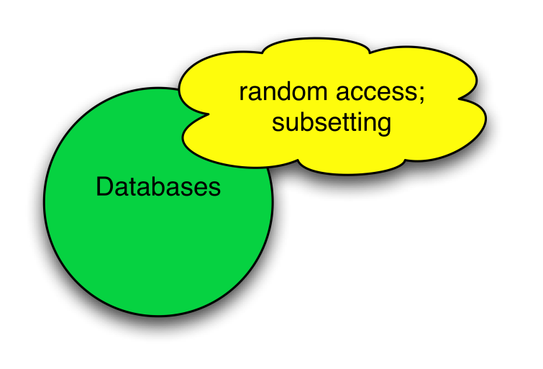
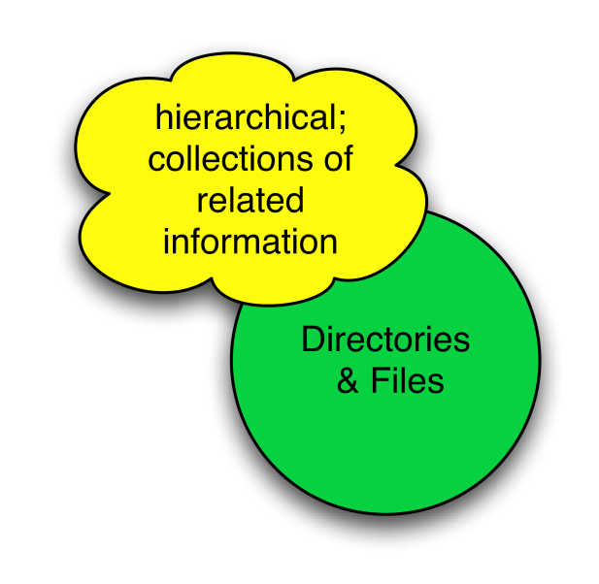
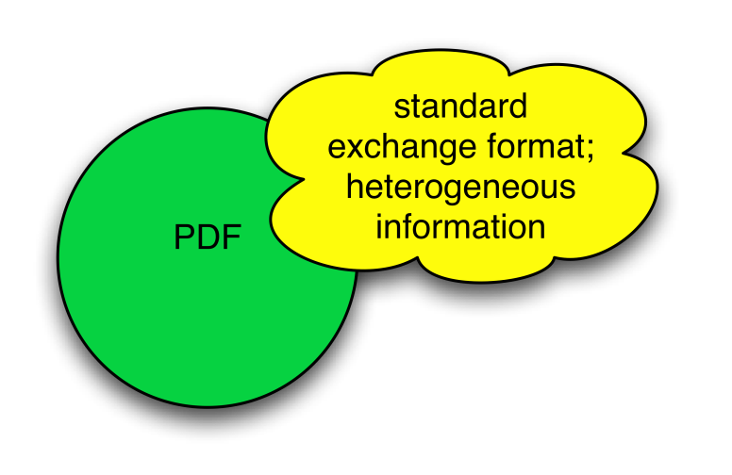
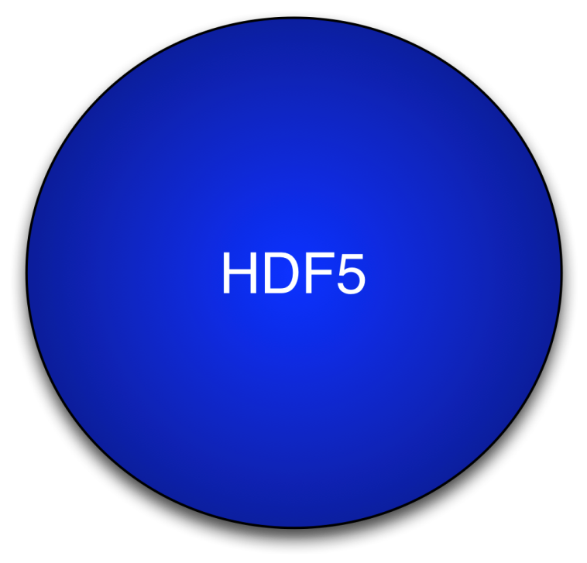
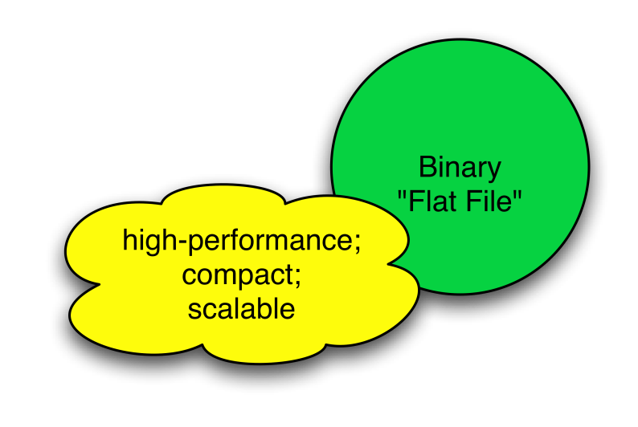
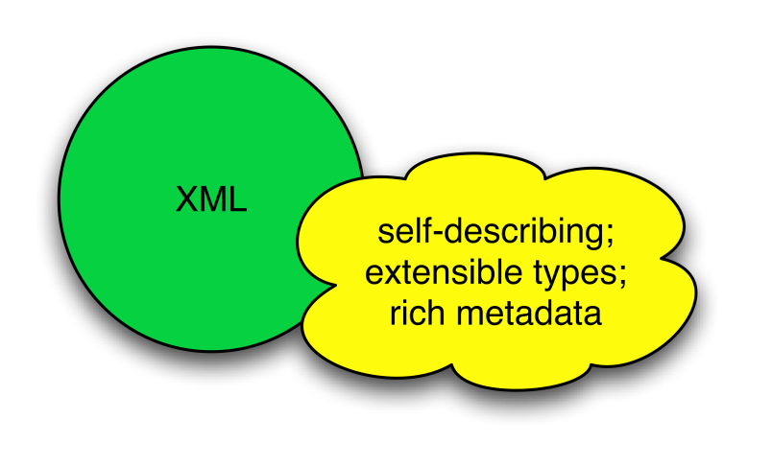
HDF5 is like …

Slide 9
Why use HDF5?
Challenging data:
  Application data that pushes the limits of what can be addressed by traditional database systems, XML documents, or in-house data formats.
Software solutions:
  For very large datasets, very fast access requirements, or very complex datasets.
  To easily share data across a wide variety of computational platforms using applications written in different programming languages.
  That take advantage of the many open-source and commercial tools that understand HDF5.
  Enabling long-term preservation of data.

Slide 10
Who uses HDF5?
Examples of HDF5 user communities
  Astrophysics
  Astronomers
  NASA Earth Science Enterprise
  Dept. of Energy Labs
  Supercomputing Centers in US, Europe and Asia
  Synchrotrons and Light Sources in US and Europe
  Financial Institutions
  NOAA
  Engineering & Manufacturing Industries
  Many others
For a more detailed list, visit
  http://www.hdfgroup.org/HDF5/users5.html

Slide 11
The HDF Group
Established in 1988
  18 years at University of Illinois’ National Center for Supercomputing Applications
  8 years as independent non-profit company:
    “The HDF Group”
The HDF Group owns HDF4 and HDF5
  HDF4 & HDF5 formats, libraries, and tools are open source and freely available with BSD-style license
Currently employ 37 people
  Always looking for more developers!

Slide 12
HDF5 Technology Platform
HDF5 Abstract Data Model
  Defines the “building blocks” for data organization and specification
  Files, Groups, Links, Datasets, Attributes, Datatypes, Dataspaces
HDF5 Software
  Tools
  Language Interfaces
  HDF5 Library
HDF5 Binary File Format
  Bit-level organization of HDF5 file
  Defined by HDF5 File Format Specification

Slide 13
HDF5 Data Model
File – Container for objects
Groups – provide structure among objects
Datasets – where the primary data goes
  Data arrays
  Rich set of datatype options
  Flexible, efficient storage and I/O
Attributes, for metadata
Everything else is built essentially from these parts.

Slide 14

Structures to organize objects
“Groups”
“/” (root)
3-D array
“/TestData”
lat | lon | temp
----|-----|-----
12 | 23 | 3.1
15 | 24 | 4.2
17 | 21 | 3.6
palette
Table
Raster image
Raster image
2-D array
“Datasets”
Notes:
This shows that you can mix objects of different types according to your needs. Typically, there will be metadata stored with objects to indicate what type of object they are.
Like HDF4, HDF5 has a grouping structure. The main difference is that every HDF5 file starts with a root group, whereas HDF4 doesn’t need any groups at all.

Slide 15

HDF5 Dataset
HDF5 Datatype
Integer: 32-bit, LE
HDF5 Dataspace
Rank
Dimensions
3
Dim[0] = 4
Dim[1] = 5
Dim[2] = 7
Specifications for single data
element and array dimensions
Multi-dimensional array of
identically typed data elements
HDF5 datasets organize and contain data elements.
  HDF5 datatype describes individual data elements.
  HDF5 dataspace describes the logical layout of the data elements.

Slide 16
HDF5 Attributes
Typically contain user metadata
Have a name and a value
Attributes “decorate” HDF5 objects
Value is described by a datatype and a dataspace
Analogous to a dataset, but do not support partial I/O operations; nor can they be compressed or extended

Slide 17
HDF5 Technology Platform
HDF5 Abstract Data Model
  Defines the “building blocks” for data organization and specification
  Files, Groups, Links, Datasets, Attributes, Datatypes, Dataspaces
HDF5 Software
  Tools
  Language Interfaces
  HDF5 Library
HDF5 Binary File Format
  Bit-level organization of HDF5 file
  Defined by HDF5 File Format Specification

Slide 18
HDF5 Software Distribution
HDF5 home page: http://hdfgroup.org/HDF5/
  Latest release: HDF5 1.8.14 (1.8.15 coming in May 2015)
HDF5 source code:
  Written in C, and includes optional C++, Fortran 90 APIs, and High Level APIs
  Contains command-line utilities (h5dump, h5repack, h5diff, ..) and compile scripts
HDF5 pre-built binaries:
  When possible, includes C, C++, F90, and High Level libraries. Check ./lib/libhdf5.settings file.
  Built with and require the SZIP and ZLIB external libraries

Slide 19
The General HDF5 API
C, Fortran, Java, C++, and .NET bindings
IDL, MATLAB, Python (h5py, PyTables)
C routines begin with prefix H5?
  ? is a character corresponding to the type of object the function acts on
Example Interfaces:
H5D : Dataset interface e.g., H5Dread
H5F : File interface e.g., H5Fopen
H5S : dataSpace interface e.g., H5Sclose

Slide 20

The HDF5 API
For flexibility, the API is extensive
  300+ functions
This can be daunting… but there is hope
  A few functions can do a lot
  Start simple
  Build up knowledge as more features are needed
Victorinox Swiss Army Cybertool 34

Slide 21
General Programming Paradigm
Object is opened or created
Object is accessed, possibly many times
Object is closed
Properties of object are optionally defined
  Creation properties (e.g., use chunking storage)
  Access properties

Slide 22
Basic Functions
H5Fcreate (H5Fopen) create (open) File
H5Screate_simple/H5Screate create Dataspace
H5Dcreate (H5Dopen) create (open) Dataset
H5Dread, H5Dwrite access Dataset
H5Dclose close Dataset
H5Sclose close Dataspace
H5Fclose close File

Slide 23
Useful Tools For New Users
h5dump:
Tool to “dump” or display contents of HDF5 files
h5cc, h5c++, h5fc:
Scripts to compile applications
HDFView:
Java browser to view HDF5 files
http://www.hdfgroup.org/hdf-java-html/hdfview/
HDF5 Examples (C, Fortran, Java, Python, Matlab)
http://www.hdfgroup.org/ftp/HDF5/examples/

Slide 24
Overview of parallel HDf5 design

Slide 25
Parallel HDF5 Requirements
Parallel HDF5 should allow multiple processes to perform I/O to an HDF5 file at the same time
  Single file image for all processes
  Compare with one file per process design:
    Expensive post processing
    Not usable by different number of processes
    Too many files produced for file system
Parallel HDF5 should use a standard parallel I/O interface
Must be portable to different platforms
Notes:
Support Message Passing Interface (MPI) programming
PHDF5 files compatible with serial HDF5 files
Shareable between different serial or parallel platforms
Single file image to all processes
One file per process design is undesirable
Expensive post processing
Not usable by different number of processes

Slide 26
Design requirements, cont
Support Message Passing Interface (MPI) programming
Parallel HDF5 files compatible with serial HDF5 files
  Shareable between different serial or parallel platforms

Slide 27
Design Dependencies
MPI with MPI-IO
  MPICH, OpenMPI
  Vendor’s MPI-IO
Parallel file system
  IBM GPFS
  Lustre
  PVFS

Slide 28
PHDF5 implementation layers
HDF5 Application
Compute node
Compute node
Compute node
HDF5 Library
MPI Library
HDF5 file on Parallel File System
Switch network + I/O servers
Disk architecture and layout of data on disk
Notes:
PHDF5 is built on top of MPI I/O APIs

Slide 29
MPI-IO vs. HDF5

Slide 30
MPI-IO
MPI-IO is an Input/Output API
It treats the data file as a “linear byte stream” and each MPI application needs to provide its own file and data representations to interpret those bytes

Slide 31
MPI-IO
All data stored are machine dependent except the “external32” representation
External32 is defined in Big Endianness
  Little-endian machines have to do the data conversion in both read or write operations
  64-bit sized data types may lose information

Slide 32
MPI-IO vs. HDF5
HDF5 is data management software
It stores data and metadata according to the HDF5 data format definition
HDF5 file is self-describing
  Each machine can store the data in its own native representation for efficient I/O without loss of data precision
  Any necessary data representation conversion is done by the HDF5 library automatically

Slide 33
Parallel HDF5 consistency semantics

Slide 34
Consistency Semantics
Consistency Semantics: Rules that define the outcome of multiple, possibly concurrent, accesses to an object or data structure by one or more processes in a computer system.

Slide 35
Parallel HDF5 Consistency Semantics
Parallel HDF5 library defines a set of consistency semantics to let users know what to expect when processes access data managed by the library.
  When the changes a process makes are actually visible to itself (if it tries to read back that data) or to other processes that access the same file with independent or collective I/O operations

Slide 36
Parallel HDF5 Consistency Semantics
Same as MPI-I/O semantics
Default MPI-I/O semantics doesn’t guarantee atomicity or sequence of above calls!
Problems may occur (although we haven’t seen any) when writing/reading HDF5 metadata or raw data
Process 0 | Process 1
MPI_File_write_at()
MPI_Barrier() | MPI_Barrier()
 | MPI_File_read_at()
Notes:
Once can close the file and then open for reading

Slide 37
Parallel HDF5 Consistency Semantics
MPI I/O provides atomicity and sync-barrier-sync features to address the issue
PHDF5 follows MPI I/O
  H5Fset_mpio_atomicity function to turn on MPI atomicity
  H5Fsync function to transfer written data to storage device (in implementation now)

Slide 38
Parallel HDF5 Consistency Semantics
For more information see “Enabling a strict consistency semantics model in parallel HDF5” linked from the HDF5 H5Fset_mpi_atomicity Reference Manual page¹
¹ http://www.hdfgroup.org/HDF5/doc/RM/Advanced/PHDF5FileConsistencySemantics/PHDF5FileConsistencySemantics.pdf

Slide 39
HDF5 parallel programming model

Slide 40
How to compile PHDF5 applications
h5pcc – HDF5 C compiler command
  Similar to mpicc
h5pfc – HDF5 F90 compiler command
  Similar to mpif90
To compile:
  % h5pcc h5prog.c
  % h5pfc h5prog.f90

Slide 41
Programming restrictions
PHDF5 opens a parallel file with an MPI communicator
  Returns a file handle
  Future access to the file via the file handle
  All processes must participate in collective PHDF5 APIs
  Different files can be opened via different communicators

Slide 42
Collective HDF5 calls
All HDF5 APIs that modify structural metadata are collective!
  File operations
    H5Fcreate, H5Fopen, H5Fclose, etc
  Object creation
    H5Dcreate, H5Dclose, etc
  Object structure modification (e.g., dataset extent modification)
    H5Dset_extent, etc
http://www.hdfgroup.org/HDF5/doc/RM/CollectiveCalls.html

Slide 43
Other HDF5 calls
Array data transfer can be collective or independent
  Dataset operations: H5Dwrite, H5Dread
  Collectiveness is indicated by function parameters, not by function names as in MPI API

Slide 44
What does PHDF5 support ?
After a file is opened by the processes of a communicator
  All parts of file are accessible by all processes
  All objects in the file are accessible by all processes
  Multiple processes may write to the same data array
  Each process may write to individual data array

Slide 45
PHDF5 API languages
C and F90, 2003 language interfaces
Most platforms with MPI-IO supported. e.g.,
  IBM BG/x
  Linux clusters
  Cray

Slide 46
Programming model
HDF5 uses access property list to control the file access mechanism
General model to access HDF5 file in parallel:
  Set up MPI-IO file access property list
  Open File
  Access Data
  Close File

Slide 47
My first parallel hdf5 program
Moving your sequential application to the HDF5 parallel world

Slide 48
Example of Serial HDF5 C program
file_id = H5Fcreate(FNAME,…, H5P_DEFAULT);
space_id = H5Screate_simple(…);
dset_id = H5Dcreate(file_id, DNAME, H5T_NATIVE_INT, space_id,…);
status = H5Dwrite(dset_id, H5T_NATIVE_INT, …, H5P_DEFAULT, …);

Slide 49
Example of Parallel HDF5 C program
Parallel HDF5 program has extra calls:
MPI_Init(&argc, &argv);
fapl_id = H5Pcreate(H5P_FILE_ACCESS);
H5Pset_fapl_mpio(fapl_id, comm, info);
file_id = H5Fcreate(FNAME,…, fapl_id);
space_id = H5Screate_simple(…);
dset_id = H5Dcreate(file_id, DNAME, H5T_NATIVE_INT, space_id,…);
xf_id = H5Pcreate(H5P_DATASET_XFER);
H5Pset_dxpl_mpio(xf_id, H5FD_MPIO_COLLECTIVE);
status = H5Dwrite(dset_id, H5T_NATIVE_INT, …, xf_id…);
MPI_Finalize();

Slide 50
Writing Patterns - Example

Slide 51
Parallel HDF5 tutorial examples
For sample programs of how to write different data patterns see:
http://www.hdfgroup.org/HDF5/Tutor/parallel.html

Slide 52
Programming model
Each process defines memory and file hyperslabs using H5Sselect_hyperslab
Each process executes a write/read call using hyperslabs defined, which can be either collective or independent
The hyperslab parameters define the portion of the dataset to write to:
  Contiguous hyperslab
  Regularly spaced data (column or row)
  Pattern
  Blocks

Slide 53
Four processes writing by rows
HDF5 "SDS_row.h5" {
GROUP "/" {
DATASET "IntArray" {
DATATYPE H5T_STD_I32BE
DATASPACE SIMPLE { ( 8, 5 ) / ( 8, 5 ) }
DATA {
10, 10, 10, 10, 10,
10, 10, 10, 10, 10,
11, 11, 11, 11, 11,
11, 11, 11, 11, 11,
12, 12, 12, 12, 12,
12, 12, 12, 12, 12,
13, 13, 13, 13, 13,
13, 13, 13, 13, 13

Slide 54
Parallel HDF5 example code
71 /*
72 * Each process defines dataset in memory and writes it to the
73 * hyperslab in the file.
74 */
75 count[0] = dims[0] / mpi_size;
76 count[1] = dims[1];
77 offset[0] = mpi_rank * count[0];
78 offset[1] = 0;
79 memspace = H5Screate_simple(RANK, count, NULL);
80
81 /*
82 * Select hyperslab in the file.
83 */
84 filespace = H5Dget_space(dset_id);
85 H5Sselect_hyperslab(filespace, H5S_SELECT_SET, offset, NULL,
count, NULL);

Slide 55
Two processes writing by columns
HDF5 "SDS_col.h5" {
GROUP "/" {
DATASET "IntArray" {
DATATYPE H5T_STD_I32BE
DATASPACE SIMPLE { ( 8, 6 ) / ( 8, 6 ) }
DATA {
1, 2, 10, 20, 100, 200,
1, 2, 10, 20, 100, 200,
1, 2, 10, 20, 100, 200,
1, 2, 10, 20, 100, 200,
1, 2, 10, 20, 100, 200,
1, 2, 10, 20, 100, 200,
1, 2, 10, 20, 100, 200,
1, 2, 10, 20, 100, 200

Slide 56
Four processes writing by pattern
HDF5 "SDS_pat.h5" {
GROUP "/" {
DATASET "IntArray" {
DATATYPE H5T_STD_I32BE
DATASPACE SIMPLE { ( 8, 4 ) / ( 8, 4 ) }
DATA {
1, 3, 1, 3,
2, 4, 2, 4,
1, 3, 1, 3,
2, 4, 2, 4,
1, 3, 1, 3,
2, 4, 2, 4,
1, 3, 1, 3,
2, 4, 2, 4

Slide 57
Four processes writing by blocks
HDF5 "SDS_blk.h5" {
GROUP "/" {
DATASET "IntArray" {
DATATYPE H5T_STD_I32BE
DATASPACE SIMPLE { ( 8, 4 ) / ( 8, 4 ) }
DATA {
1, 1, 2, 2,
1, 1, 2, 2,
1, 1, 2, 2,
1, 1, 2, 2,
3, 3, 4, 4,
3, 3, 4, 4,
3, 3, 4, 4,
3, 3, 4, 4

Slide 58
Complex data patterns
HDF5 doesn’t have restrictions on data patterns and data balance
1
2
3
4
5
6
7
8
1
2
3
4
5
6
7
8
9
10
11
12
13
14
15
16
9
10
11
12
13
14
15
16
17
18
19
20
21
22
23
24
17
18
19
20
21
22
23
24
25
26
27
28
29
30
31
32
25
26
27
28
29
30
31
32
33
34
35
36
37
38
39
40
33
34
35
36
37
38
39
40
41
42
43
44
45
46
47
48
41
42
43
44
45
46
47
48
49
50
51
52
53
54
55
56
49
50
51
52
53
54
55
56
57
58
59
60
61
62
63
64
57
58
59
60
61
62
63
64
1
2
3
4
5
6
7
8
9
10
11
12
13
14
15
16
17
18
19
20
21
22
23
24
25
26
27
28
29
30
31
32
33
34
35
36
37
38
39
40
41
42
43
44
45
46
47
48
49
50
51
52
53
54
55
56
57
58
59
60
61
62
63
64

Slide 59
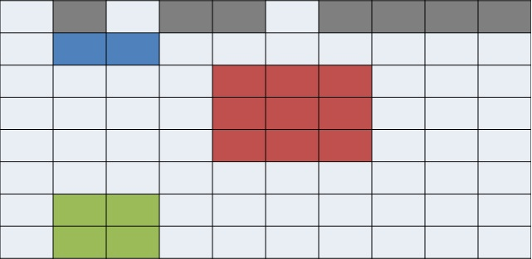
Examples of irregular selection
Internally, the HDF5 library creates an MPI datatype for each lower dimension in the selection and then combines those types into one giant structured MPI datatype

Slide 60
Performance analysis

Slide 61
Performance analysis
Some common causes of poor performance
Possible solutions

Slide 62
My PHDF5 application I/O is slow
  “Tuning HDF5 for Lustre File Systems” by Howison, Koziol, Knaak, Mainzer, and Shalf¹
    Chunking and hyperslab selection
    HDF5 metadata cache
    Specific I/O system hints
¹http://www.hdfgroup.org/pubs/papers/howison_hdf5_lustre_iasds2010.pdf

Slide 63
Independent vs. collective raw data i/o

Slide 64
Collective vs. independent calls
MPI definition of collective calls:
  All processes of the communicator must participate in calls in the right order. E.g.,
    Process1 Process2
    call A(); call B(); call A(); call B(); **right**
    call A(); call B(); call B(); call A(); **wrong**
Independent means not collective ☺
Collective is not necessarily synchronous, nor must require communication

Slide 65
Independent vs. collective access
User reported independent data transfer mode was much slower than the collective data transfer mode
Data array was tall and thin: 230,000 rows by 6 columns
:
:
:
230,000 rows
:
:
:

Slide 66
Debug Slow Parallel I/O Speed(1)
Writing to one dataset
  Using 4 processes == 4 columns
  HDF5 datatype is 8-byte doubles
  4 processes, 1000 rows == 4x1000x8 = 32,000 bytes
% mpirun -np 4 ./a.out 1000
  Execution time: 1.783798 s.
% mpirun -np 4 ./a.out 2000
  Execution time: 3.838858 s.
Difference of 2 seconds for 1000 more rows = 32,000 bytes.
Speed of 16KB/sec!!! Way too slow.

Slide 67
Debug slow parallel I/O speed(2)
Build a version of PHDF5 with
  ./configure --enable-debug --enable-parallel …
  This allows the tracing of MPIO I/O calls in the HDF5 library.
E.g., to trace
  MPI_File_read_xx and MPI_File_write_xx calls
  % setenv H5FD_mpio_Debug “rw”

Slide 68
Debug slow parallel I/O speed(3)
% setenv H5FD_mpio_Debug ’rw’
% mpirun -np 4 ./a.out 1000 # Indep.; contiguous.
in H5FD_mpio_write mpi_off=0 size_i=96
in H5FD_mpio_write mpi_off=0 size_i=96
in H5FD_mpio_write mpi_off=0 size_i=96
in H5FD_mpio_write mpi_off=0 size_i=96
in H5FD_mpio_write mpi_off=2056 size_i=8
in H5FD_mpio_write mpi_off=2048 size_i=8
in H5FD_mpio_write mpi_off=2072 size_i=8
in H5FD_mpio_write mpi_off=2064 size_i=8
in H5FD_mpio_write mpi_off=2088 size_i=8
in H5FD_mpio_write mpi_off=2080 size_i=8
…
Total of 4000 of these little 8 bytes writes == 32,000 bytes.

Slide 69
Independent calls are many and small
Each process writes one element of one row, skips to next row, write one element, so on.
Each process issues 230,000 writes of 8 bytes each.
:
:
:
230,000 rows
:
:
:

Slide 70
Debug slow parallel I/O speed (4)
% setenv H5FD_mpio_Debug ’rw’
% mpirun -np 4 ./a.out 1000 # Indep., Chunked by column.
in H5FD_mpio_write mpi_off=0 size_i=96
in H5FD_mpio_write mpi_off=0 size_i=96
in H5FD_mpio_write mpi_off=0 size_i=96
in H5FD_mpio_write mpi_off=0 size_i=96
in H5FD_mpio_write mpi_off=3688 size_i=8000
in H5FD_mpio_write mpi_off=11688 size_i=8000
in H5FD_mpio_write mpi_off=27688 size_i=8000
in H5FD_mpio_write mpi_off=19688 size_i=8000
in H5FD_mpio_write mpi_off=96 size_i=40
in H5FD_mpio_write mpi_off=136 size_i=544
in H5FD_mpio_write mpi_off=680 size_i=120
in H5FD_mpio_write mpi_off=800 size_i=272
…
Execution time: 0.011599 s.

Slide 71
Use collective mode or chunked storage
Collective I/O will combine many small independent calls into few but bigger calls
Chunks of columns speeds up too
:
:
:
230,000 rows
:
:
:

Slide 72
Collective vs. independent write

Slide 73
Collective I/O in HDF5
Set up using a Data Transfer Property List (DXPL)
All processes must participate in the I/O call (H5Dread/write) with a selection (which could be a NULL selection)
Some cases where collective I/O is not used even when the use asks for it:
  Data conversion
  Compressed Storage
  Chunking Storage:
    When the chunk is not selected by a certain number of processes

Slide 74
Enabling Collective Parallel I/O with HDF5
/* Set up file access property list w/parallel I/O access */
fa_plist_id = H5Pcreate(H5P_FILE_ACCESS);
H5Pset_fapl_mpio(fa_plist_id, comm, info);
/* Create a new file collectively */
file_id = H5Fcreate(filename, H5F_ACC_TRUNC,
H5P_DEFAULT, fa_plist_id);
/* <omitted data decomposition for brevity> */
/* Set up data transfer property list w/collective MPI-IO */
dx_plist_id = H5Pcreate(H5P_DATASET_XFER);
H5Pset_dxpl_mpio(dx_plist_id, H5FD_MPIO_COLLECTIVE);
/* Write data elements to the dataset */
status = H5Dwrite(dset_id, H5T_NATIVE_INT,
memspace, filespace, dx_plist_id, data);

Slide 75
Collective I/O in HDF5
Can query Data Transfer Property List (DXPL) after I/O for collective I/O status:
  H5Pget_mpio_actual_io_mode
    Retrieves the type of I/O that HDF5 actually performed on the last parallel I/O call
  H5Pget_mpio_no_collective_cause
    Retrieves local and global causes that broke collective I/O on the last parallel I/O call
  H5Pget_mpio_actual_chunk_opt_mode
    Retrieves the type of chunk optimization that HDF5 actually performed on the last parallel I/O call. This is not necessarily the type of optimization requested

Slide 76
Effect of HDF5 storage

Slide 77
Contiguous storage
Metadata header separate from dataset data
Data stored in one contiguous block in HDF5 file
Application memory
Metadata cache
Dataset header
………….
Dataset data
Datatype
Dataspace
………….
Attributes
…
File
Dataset data

Slide 78
On a parallel file system
File
Dataset data
OST 1
OST 2
OST 3
OST 4
The file is striped over multiple OSTs depending on the stripe size and stripe count that the file was created with.

Slide 79
Chunked storage
Data is stored in chunks of predefined size
  Two-dimensional instance may be referred to as data tiling
HDF5 library writes/reads the whole chunk
Contiguous
Chunked

Slide 80
Chunked storage (cont.)
Dataset data is divided into equally sized blocks (chunks).
Each chunk is stored separately as a contiguous block in HDF5 file.
Application memory
Metadata cache
Dataset data
Dataset header
A
B
C
D
………….
Datatype
Dataspace
………….
Chunk
index
Attributes
…
File
header
Chunk
index
A
C
D
B

Slide 81
On a parallel file system
File
header
Chunk
index
A
C
D
B
OST 1
OST 2
OST 3
OST 4
The file is striped over multiple OSTs depending on the stripe size and stripe count that the file was created with

Slide 82
Which is better for performance?
It depends!!
Consider these selections:
If contiguous: 2 seeks
If chunked: 10 seeks
If contiguous: 16 seeks
If chunked: 4 seeks
Add to that striping over a Parallel File System, which makes this problem very hard to solve!

Slide 83
Chunking and hyperslab selection
P1
P2
P3
When writing or reading, try to use hyperslab selections that coincide with chunk boundaries.

Slide 84
Parallel I/O on chunked datasets
Multiple options for performing I/O when collective:
  Operate on all chunks in one collective I/O operation: “Linked chunk I/O”
  Operate on each chunk collectively: “Multi-chunk I/O”
  Break collective I/O and perform I/O on each chunk independently (also in “Multi-chunk I/O” algorithm)

Slide 85
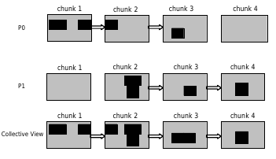
Linked chunk I/O
One MPI Collective I/O Call

Slide 86
Multi-chunk I/O
Collective I/O per chunk
Determine for each chunk if enough processes have a selection inside to do collective I/O
If not enough, use independent I/O

Slide 87
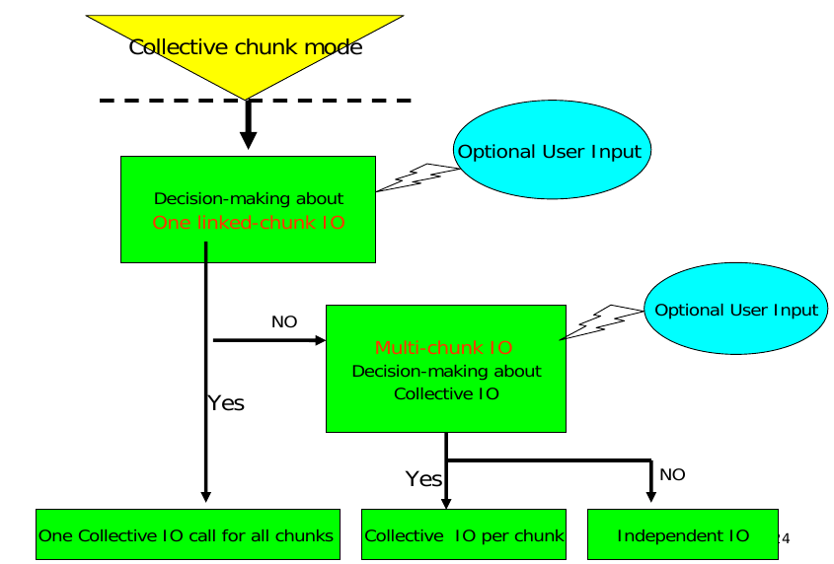
Decision making

Slide 88
Effect of HDF5 metadata cache

Slide 89
Parallel HDF5 and Metadata
Metadata operations:
  Creating/removing a dataset, group, attribute, etc…
  Extending a dataset’s dimensions
  Modifying group hierarchy
  etc …
All operations that modify metadata are collective, i.e., all processes have to call that operation:
  If you have 10,000 processes running your application, and one process needs to create a dataset, ALL processes must call H5Dcreate to create 1 dataset.

Slide 90
Space allocation
Allocating space at the file’s EOF is very simple in serial HDF5 applications:
  The EOF value begins at offset 0 in the file
  When space is required, the EOF value is incremented by the size of the block requested.
Space allocation using the EOF value in parallel HDF5 applications can result in a race condition if processes do not synchronize with each other:
  Multiple processes believe that they are the sole owner of a range of bytes within the HDF5 file.
Solution: Make it Collective

Slide 91
Example
Consider this case, where 2 processes want to create a dataset each.
P1
P2
H5Dcreate(D1)
H5Dcreate(D2)
Each call has to allocate space in file to store the dataset header.
Bytes 4 to 10 in the file are free
Bytes 4 to 10 in the file are free
Conflict!

Slide 92
Example
P1
P2
H5Dcreate(D1)
H5Dcreate(D1)
Allocate space in file to store the dataset header.
Bytes 4 to 10 in the file are free.
Create the dataset.
H5Dcreate(D2)
H5Dcreate(D2)
Allocate space in file to store the dataset header.
Bytes 11 to 17 in the file are free.
Create the dataset.

Slide 93
Metadata cache
To handle synchronization issues, all HDF5 operations that could potentially modify the metadata in an HDF5 file are required to be collective
  A list of these routines is available in the HDF5 reference manual:http://www.hdfgroup.org/HDF5/doc/RM/CollectiveCalls.html

Slide 94
Managing the metadata cache
All operations that modify metadata in the HDF5 file are collective:
  All processes will have the same dirty metadata entries in their cache (i.e., metadata that is inconsistent with what is on disk).
  Processes are not required to have the same clean metadata entries (i.e., metadata that is in sync with what is on disk).
Internally, the metadata cache running on process 0 is responsible for managing changes to the metadata in the HDF5 file.
  All the other caches must retain dirty metadata until the process 0 cache tells them that the metadata is clean (i.e., on disk).

Slide 95
Example
Metadata Cache is clean for all processes:
P0
P1
P2
P3
E1
E2
E3
E4
E1
E7
E8
E2
E4
E6
E1
E5
E12
E32
E1
E4

Slide 96
Example
All processes call H5Gcreate that modifies metadata entry E3 in the file:
P0
P1
P2
P3
E3
E1
E2
E4
E3
E1
E7
E8
E3
E4
E6
E1
E3
E12
E32
E1

Slide 97
Example
All processes call H5Dcreate that modifies metadata entry E2 in the file:
P0
P1
P2
P3
E3
E2
E1
E4
E3
E2
E1
E7
E3
E2
E4
E6
E3
E2
E12
E32

Slide 98
Example
Process 0 calls H5Dopen on a dataset accessing entry E5
P0
P1
P2
P3
E5
E3
E2
E1
E3
E2
E1
E7
E3
E2
E4
E6
E3
E2
E12
E32

Slide 99
Flushing the cache
Initiated when:
  The size of dirty entries in cache exceeds a certain threshold
  The user calls a flush
The actual flush of metadata entries to disk is currently implemented in two ways:
  Single Process (Process 0) write
  Distributed write

Slide 100
Single Process (Process 0) write
All processes enter a synchronization point.
Process 0 writes all the dirty entries to disk while other processes wait
Process 0 marks all the dirty entries as clean
Process 0 broadcasts the cleaned entries to all processes, which mark them as clean too

Slide 101
Distributed write
All processes enter a synchronization point.
Process 0 broadcasts the metadata that needs to be flushed to all processes
Each process algorithmically determines which metadata cache entries it should write, and writes them to disk independently
All processes mark the flushed metadata as clean

Slide 102
Parallel tools

Slide 103
Parallel tools
h5perf
  Performance measuring tool showing I/O performance for different I/O APIs

Slide 104
h5perf
An I/O performance measurement tool
Tests 3 File I/O APIs:
  POSIX I/O (open/write/read/close…)
  MPI-I/O (MPI_File_{open,write,read,close})
  HDF5 (H5Fopen/H5Dwrite/H5Dread/H5Fclose)
An indication of I/O speed upper limits

Slide 105
Useful parallel HDF5 links
Parallel HDF information site
  http://www.hdfgroup.org/HDF5/PHDF5/
Parallel HDF5 tutorial available at
  http://www.hdfgroup.org/HDF5/Tutor/
HDF Help email address
  help@hdfgroup.org

Slide 106
Upcoming features in hdf5

Slide 107
PHDF5 Improvements in Progress
Multi-dataset read/write operations
  Allows single collective operation on multiple datasets
    Similar to PnetCDF “write-combining” feature
  H5Dmulti_read/write(<array of datasets, selections, etc>)
  Order of magnitude speedup

Slide 108
H5Dwrite vs. H5Dwrite_multi
Chunked floating-point datasets
Rank = 1
Dims = 200
Chunk size = 20

Slide 109

H5Dwrite vs. H5Dwrite_multi
Contiguous floating-point datasets

Slide 110
PHDF5 Improvements in Progress
Avoid file truncation
  File format currently requires call to truncate file, when closing
  Expensive in parallel (MPI_File_set_size)
  Change to file format will eliminate truncate call

Slide 111
PHDF5 Improvements in Progress
Collective Object Open
  Currently, object open is independent
  All processes perform I/O to read metadata from file, resulting in I/O storm at file system
  Change will allow a single process to read, then broadcast metadata to other processes

Slide 112
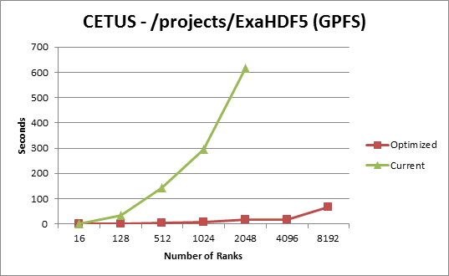
Collective Object Open Performance

Slide 113
autotuning
Research Focus -

Slide 114
Autotuning Background
Software Autotuning:
  Employ empirical techniques to evaluate a set of alternative mappings of computation kernels to an architecture and select the mapping that obtains the best performance.
Autotuning Categories:
  Self-tuning library generators such as ATLAS, PhiPAC and OSKI for linear algebra, etc.
  Compiler-based autotuners that automatically generate and search a set of alternative implementations of a computation
  Application-level autotuners that automate empirical search across a set of parameter values proposed by the application programmer

Slide 115
HDF5 Autotuning
Why?
  Because the dominant I/O support request at NERSC is poor I/O performance, many/most of which can be solved by enabling Lustre striping, or tuning another I/O parameter
  Users shouldn’t have to figure this stuff out!
Two Areas of Focus:
  Evaluate techniques for autotuning HPC application I/O
    File system, MPI, HDF5
  Record and Replay HDF5 I/O operations

Slide 116
Autotuning HPC I/O
Goal: Avoid tuning each application to each machine and file system
  Create I/O autotuner library that can inject “optimal” parameters for I/O operations on a given system
Using Darshan* tool to create wrappers for HDF5 calls
  Application can be dynamically linked with I/O autotuning library
  No changes to application or HDF5 library
Using several HPC applications currently:
  VPIC, GCRM, Vorpal
* - http://www.mcs.anl.gov/research/projects/darshan/

Slide 117
Autotuning HPC I/O
Initial parameters of interest
  File System (Lustre): stripe count, stripe unit
  MPI-I/O: Collective buffer size, coll. buffer nodes
  HDF5: Alignment, sieve buffer size

Slide 118
Autotuning HPC I/O

Slide 119
Autotuning HPC I/O
Autotuning Exploration/Generation Process:
  Iterate over running application many times:
    Intercept application’s I/O calls
    Inject autotuning parameters
    Measure resulting performance
Analyze performance information from many application runs to create configuration file, with best parameters found for application/machine/file system

Slide 120
Autotuning HPC I/O
Using the I/O Autotuning Library:
  Dynamically link with I/O autotuner library
  I/O autotuner library automatically reads parameters from config file created during exploration process
  I/O autotuner automatically injects autotuning parameters as application operates

Slide 121
Autotuning HPC I/O

Slide 122
Autotuning HPC I/O

Slide 123
Autotuning HPC I/O

Slide 124
Autotuning in HDF5
“Auto-Tuning of Parallel IO Parameters for HDF5 Applications”, Babak Behzad, et al, poster @ SC12
"Taming Parallel I/O Complexity with Auto-Tuning”, Babak Behzad, et al, SC13

Slide 125
Autotuning HPC I/O
Remaining research:
  Determine “speed of light” for I/O on system and use that to define “good enough” performance
  Entire space is too large to fully explore, we are now evaluating genetic algorithm techniques to help find “good enough” parameters
  How to factor out “unlucky” exploration runs
  Methods for avoiding overriding application parameters with autotuned parameters

Slide 126
Other HDF5 Improvements in Progress
Single-Writer/Multiple-Reader (SWMR)
Virtual Object Layer (VOL)
Virtual Datasets

Slide 127
Single-Writer/Multiple-Reader (SWMR)
Improves HDF5 for Data Acquisition:
  Allows simultaneous data gathering and monitoring/analysis
  Focused on storing data sequences for high-speed data sources
Supports ‘Ordered Updates’ to file:
  Crash-proofs accessing HDF5 file
  Possibly uses small amount of extra space

Slide 128
Virtual object layer (vOL)

Slide 129
Virtual Object Layer (VOL)
Goal
  Provide an application with the HDF5 data model and API, but allow different underlying storage mechanisms
New layer below HDF5 API
  Intercepts all API calls that can touch the data on disk and routes them to a VOL plugin
Potential VOL plugins:
  Native HDF5 driver (writes to HDF5 file)
  Raw driver (maps groups to file system directories and datasets to files in directories)
  Remote driver (the file exists on a remote machine)

Slide 130
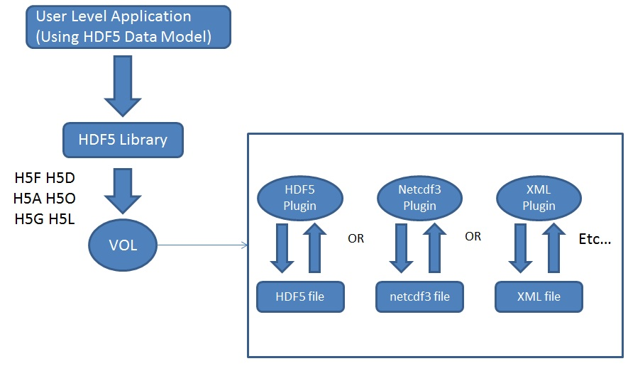
VOL Plugins
VOL plugins

Slide 131
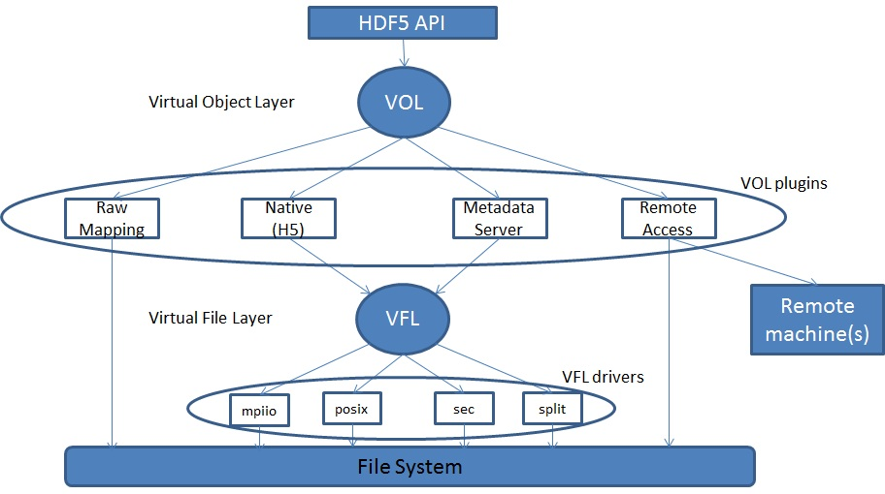
Virtual Object Layer

Slide 132
Why not use the VFL?
VFL is implemented below the HDF5 abstract model
  Deals with blocks of bytes in the storage container
  Does not recognize HDF5 objects nor abstract operations on those objects
VOL is layered right below the API layer to capture the HDF5 data model

Slide 133
Sample API Function Implementation
hid_t H5Dcreate2 (hid_t loc_id, const char *name, hid_t type_id, hid_t space_id, hid_t lcpl_id, hid_t dcpl_id, hid_t dapl_id) {
/* Check arguments */
…
/* call corresponding VOL callback for H5Dcreate */
dset_id = H5_VOL_create (TYPE_DATASET, …);
/*
Return result to user (yes the dataset is created,
or no here is the error)
*/
return dset_id;
}

Slide 134
considerations
Work in progress: VOL

Slide 135
VOL Plugin Selection
Use a pre-defined VOL plugin:
  hid_t fapl = H5Pcreate(H5P_FILE_ACCESS);
  H5Pset_fapl_mds_vol(fapl, …);
  hid_t file = H5Fcreate("foo.h5", …, …, fapl);
  H5Pclose(fapl);
Register user defined VOL plugin:
  H5VOLregister (H5VOL_class_t *cls)
  H5VOLunregister (hid_t driver_id)
  H5Pget_plugin_info (hid_t plist_id)

Slide 136
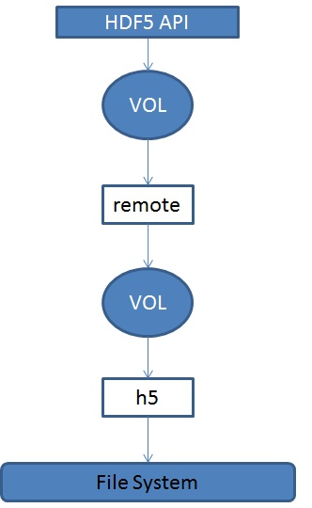
Interchanging and Stacking Plugins
Interchanging VOL plugins
  Should be a valid thing to do
  User’s responsibility to ensure plugins coexist
Stacking plugins
Stacking should make sense.
For example, the first VOL plugin in a stack could be a statistics plugin, that does nothing but gather information on what API calls are made and their corresponding parameters.

Slide 137
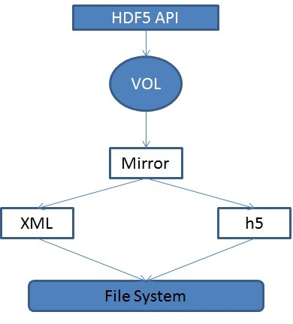
Mirroring
Extension to stacking
HDF5 API calls are forwarded through a mirror plugin to two or more VOL plugins

Slide 138
Sample Plugins: Metadata Server
Application processes
Set aside process
Compute Nodes
MDS
Metadata
H5F H5D H5A H5O H5G H5L
VOL
HDF5 container
Raw Data File
Metadata File

Slide 139
Raw Plugin
The flexibility of the virtual object layer provides developers with the option to abandon the single file, binary format like the native HDF5 implementation.
A “raw” file format could map HDF5 objects (groups, datasets, etc …) to file system objects (directories, files, etc …).
The entire set of raw file system objects created would represent one HDF5 container.

Slide 140
Remote Plugin
A remote VOL plugin would allow access to files located on a server.
Prototyping two implementations:
  Web-services via RESTful access:
    http://www.hdfgroup.org/projects/hdfserver/
  Native HDF5 file access over sockets:
    http://svn.hdfgroup.uiuc.edu/h5netvol/trunk/

Slide 141
Implementation
VOL Class
  Data structure containing general variables and a collection of function pointers for HDF5 API calls
Function Callbacks
  API routines that potentially touch data on disk
  H5F, H5D, H5A, H5O, H5G, H5L, and H5T

Slide 142
Implementation
We will end up with a large set of function callbacks:
  Lump all the functions together into one data structure OR
  Have a general class that contains all common functions, and then children of that class that contain functions specific to certain HDF5 objects OR
  For each object have a set of callbacks that are specific to that object (This is design choice that has been taken).

Slide 143
Filters
Need to keep HDF5 filters in mind
Where is the filter applied, before or after the VOL plugin?
  Logical guess now would be before, to avoid having all plugins deal with filters

Slide 144
Current status of VOL
?

Slide 145
Virtual Datasets
Mechanism for creating a composition of multiple source datasets, while accessing through single virtual dataset
Modifications to source datasets are visible to virtual dataset
  And writing to virtual dataset modifies source datasets
Can have subset within source dataset mapped to subsets within virtual dataset
Source and virtual datasets can have unlimited dimensions
Source datasets can be virtual datasets themselves

Slide 146
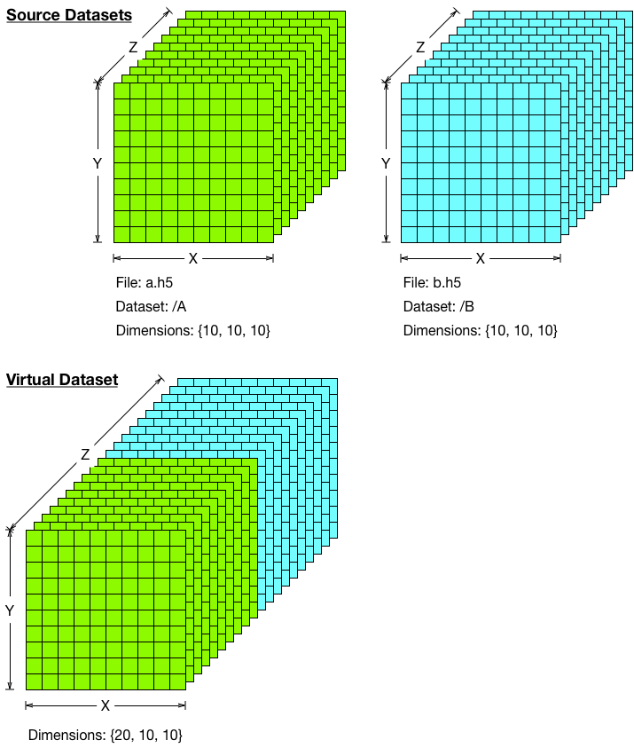
Virtual Datasets, Example 1

Slide 147
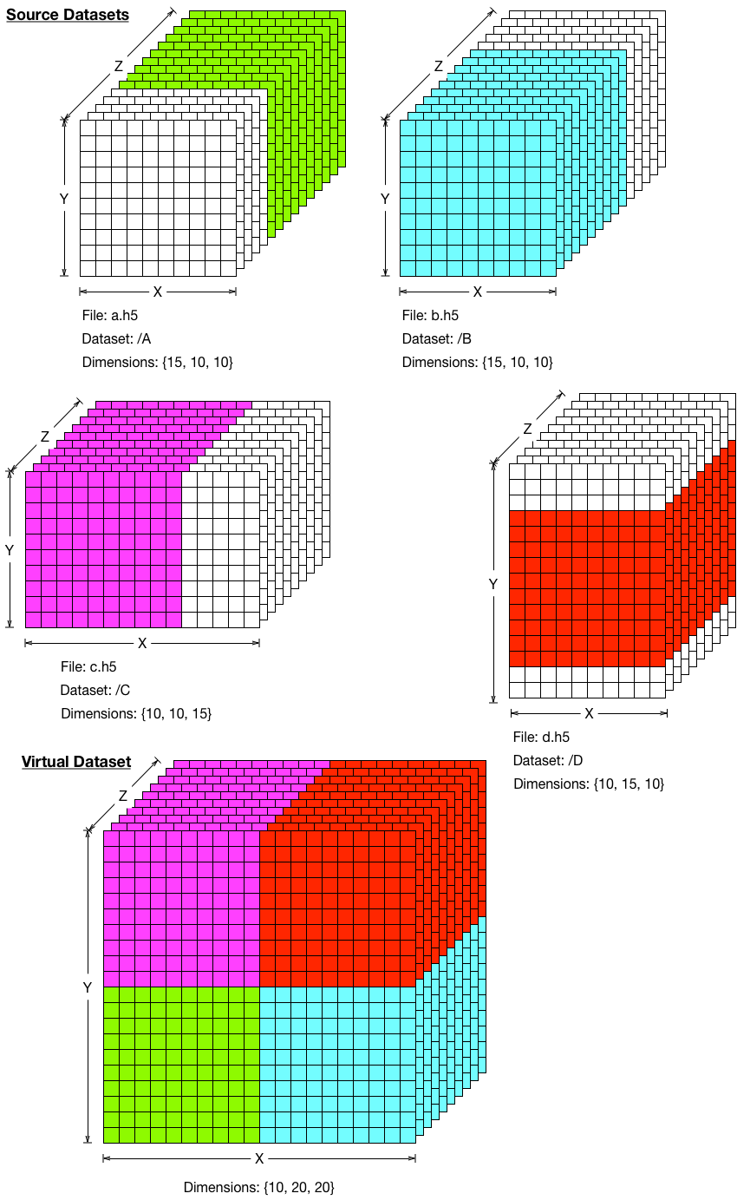
Virtual Datasets, Example 2

Slide 148
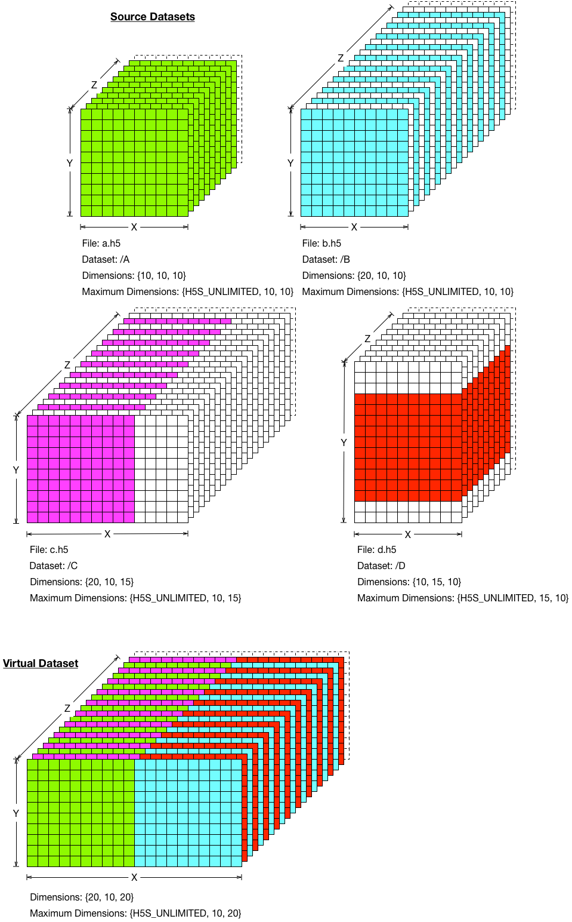
Virtual Datasets, Example 3

Slide 149
HDF5 Roadmap
Concurrency
  Single-Writer/Multiple-Reader (SWMR)
  Internal threading
Virtual Object Layer (VOL)
Data Analysis
  Query / View / Index APIs
Native HDF5 client/server
Performance
  Scalable chunk indices
  Metadata aggregation and Page buffering
  Asynchronous I/O
  Variable-length records
Fault tolerance
Parallel I/O
I/O Autotuning
“The best way to predict the future is to invent it.”
– Alan Kay
Extreme Scale Computing HDF5

Slide 150
Thank You!
Questions?

Slide 151

Codename “HEXAD”
Excel is a great frontend with a not so great rear ;-)
We’ve fixed that with an HDF5 Excel Add-in
Let’s you do the usual things including:
  Display content (file structure, detailed object info)
  Create/read/write datasets
  Create/read/update attributes
Plenty of ideas for bells an whistles, e.g., HDF5 image & PyTables support
Send in* your Must Have/Nice To Have feature list!
Stay tuned for the beta program
* help@hdfgroup.org

Slide 152

HDF Server
REST-based service for HDF5 data
Reference Implementation for REST API
Developed in Python using Tornado Framework
Supports Read/Write operations
Clients can be Python/C/Fortran or Web Page
Let us know what specific features you’d like to see. E.g. VOL REST Client Plugin

Slide 153
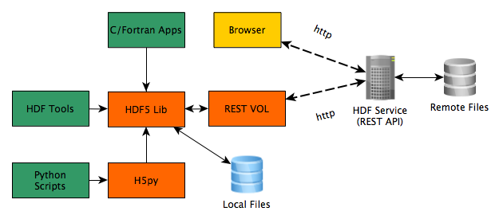
HDF Server Architecture

Slide 154
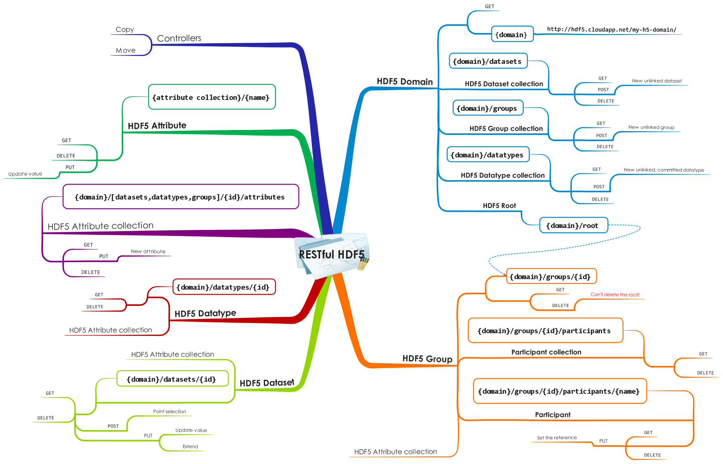
Restless About HDF5/REST

Slide 155
HDF Compass
“Simple” HDF5 Viewer application
Cross platform (Windows/Mac/Linux)
Native look and feel
Can display extremely large HDF5 files
View HDF5 files and OpenDAP resources
Plugin model enables different file formats/remote resources to be supported
Community-based development model

Slide 156
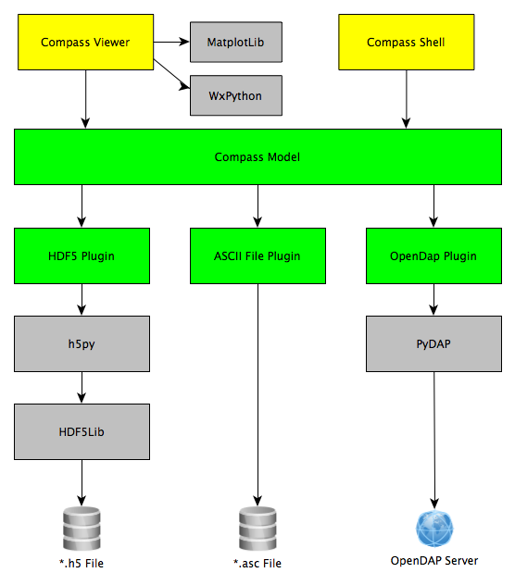
Compass Architecture

