Slide 1
High-performance Parallel Preconditioning for Large-scale Reservoir Simulation Through Multiscale, Architecture-aware Techniques
Abdulrahman Manea, Dept. of Energy Resources, Stanford University
Jason Sewall*, DCG MICRO, Intel
Hamdi Tchelepi, Dept. of Energy Resources, Stanford University

Slide 2
Legal Disclaimers
Copyright © 2014 Intel Corporation
Intel, Xeon, Intel Xeon Phi, Pentium, Cilk, VTune and the Intel logo are trademarks of Intel Corporation in the U.S. and other countries.
*Other names and brands may be claimed as the property of others.
Software and workloads used in performance tests may have been optimized for performance only on Intel microprocessors. Performance tests, such as SYSmark* and MobileMark*, are measured using specific computer systems, components, software, operations and functions. Any change to any of those factors may cause the results to vary. You should consult other information and performance tests to assist you in fully evaluating your contemplated purchases, including the performance of that product when combined with other products. For more information go to http://www.intel.com/performance.
Optimization Notice
Intel's compilers may or may not optimize to the same degree for non-Intel microprocessors for optimizations that are not unique to Intel microprocessors. These optimizations include SSE2, SSE3, and SSE3 instruction sets and other optimizations. Intel does not guarantee the availability, functionality, or effectiveness of any optimization on microprocessors not manufactured by Intel.
Microprocessor-dependent optimizations in this product are intended for use with Intel microprocessors. Certain optimizations not specific to Intel microarchitecture are reserved for Intel microprocessors. Please refer to the applicable product User and Reference Guides for more information regarding the specific instruction sets covered by this notice.
Notice revision #20110804

Slide 3
Bigger problems, faster simulations
In HPC, how are problem sizes chosen?
  How long will it take to get an answer?
  Minimum problem sizes
  Ensembles of problems might fill up nodes….
If only solvers were faster, solvers more scalable…
  We could run bigger problems
    More detail, (weak scaling)
    Lower latency to solution (strong scaling)

Slide 4
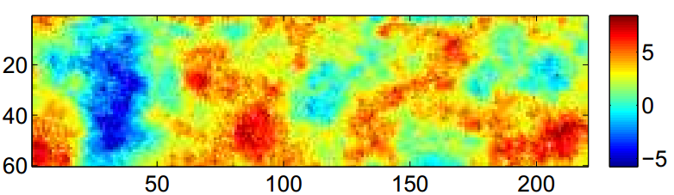
Reservoir Simulation
Hard to scale
  Elliptic,, large timesteps, Newton-Krylov
Nonlinear
Ill-conditioned
  > 10 orders of magnitude variation
Log10(k)
SPE10 – Top Layer

Slide 5
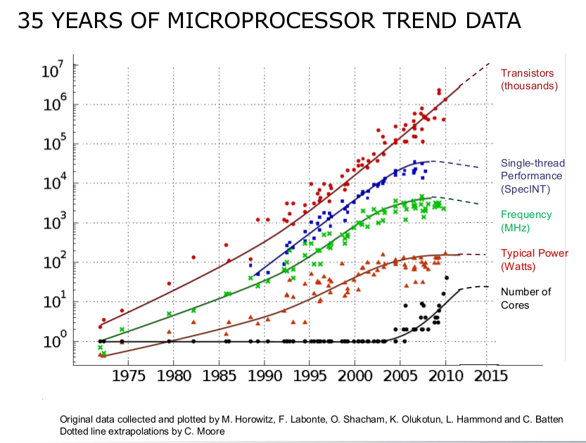
Power in hardware, solutions in algorithms
Moore’s law continues
  Some codes soar, others not
Too much focus on “code”
  OMP, CUDA, OpenCL
Algorithms are key
Understanding basics of architecture
  SIMD
  Multi core
  Functional units
  Memory hierarchy

Slide 6
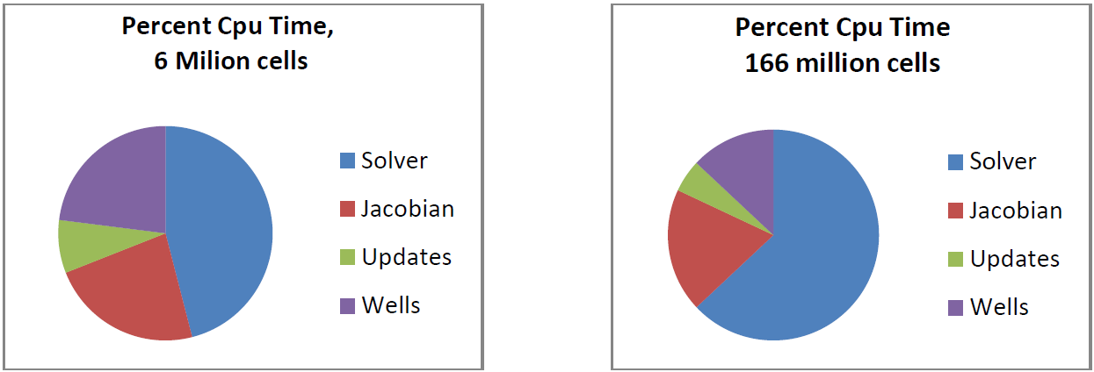
Reservoir Simulation – Performance Breakdown
Most of the simulation time is spent at the linear solver:
  e.g. *
Aramco’s GigaPOWERS®
* simulation of 37 years of production on 720 Westmere cores and 5,640 Westmere cores, respectively, (SPE 142297)

Slide 7
Krylov subspace method-the innermost loop
Read input data (problem definition)
Initialize (initial conditions)
Start timestep calculation (timestepping)
  Set an initial timestep
  Set production/injection rates for current timestep
  Linearize equations
  Start Newton loop
    Form the Jacobian System
    Solve the Jacobian System by a direct or an iterative method
    Update the solution
    Repeat until convergence, otherwise cut reduce timestep and start Newton loop over again
  Post process results at specified times
If ending conditions are not reached:
  Increment time (perform a timestep), and go to step 3
Linear Solver
Non-linear Solver

Slide 8
The Need for Preconditioners
Linear Solver Algorithm
  Preconditioned Krylov Subspace Method (GMRES)
Why bother preconditioning? *
*SPE10 – Top Layer (1.2 M cells)
Notes:
What did we do that ‘weakened us’ w.r.t. SAMG for SPE10?

Slide 9
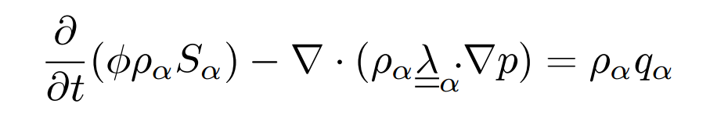
Spectral character of the system
α component
ρ density
λ mobility ratio (k/μ)
S saturation
∅ porosity
q volumetric source
p pressure
Both hyperbolic and elliptic components
No solver ideal for both
    Use constrained pressure residual to address difficult pressure system
  Solvers for heterogeneous Poisson problems
    FFT
      Not applicable to heterogeneity/BCs
    Jacobi/ILU
      Not scalable/’powerful’ enough
    Algebraic Multigrid
      Very applicable
      Setup isn’t very scalable
  No amount of #omp parallel will fix this!
  Need new algorithm with
    Load balancing
    Divisible/minimized working set

Slide 10
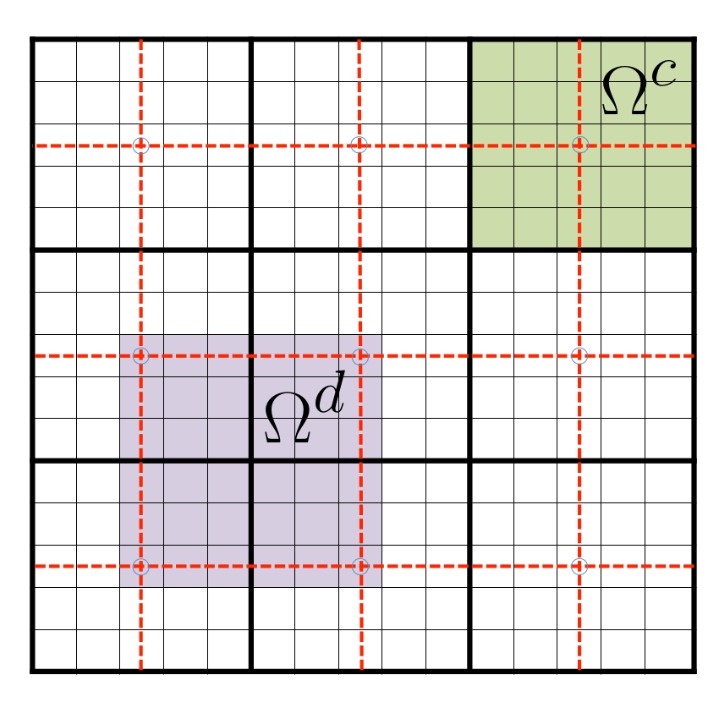

Multiscale Finite Element Solver
Elliptic Solver based on domain decomposition
  Partition domain $Ω$ into N_{c} subdomains $Ω_{i}^{c}$
    Associate with coarse unknowns & basis functions
  Solve coarse system, transfer to fine
Solve independent, small system for each basis & for coarse stage

Slide 11
Scalable setup phase
  Dual domain-centric approach
    Perform each LU once, and apply 4(8) FB Solves
    Assemble into transfer (prolongation/restriction) operator
    Solutions feed local portions of coarse system A^{c}=P^{T}A^{f}P
  Each region of the fine operator is used exactly once
  Work in each region completely independent
    Small teams of threads can cooperate
    Supernodes can be used to do exploit vectorization
  Domains easy to load balance
  Coarse system is small & cache-resident, can be factored in parallel

Slide 12
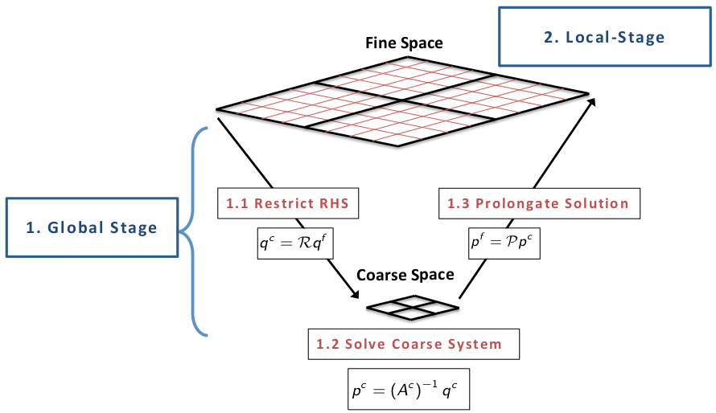
Scalable solution phase
Solution step
  Global
    Restrict fine rhs (per domain)
    Coarse triangular solve (cooperatively)
    Prolong coarse solution (per domain)
  Local
    Smoother stage (per domain)

Slide 13
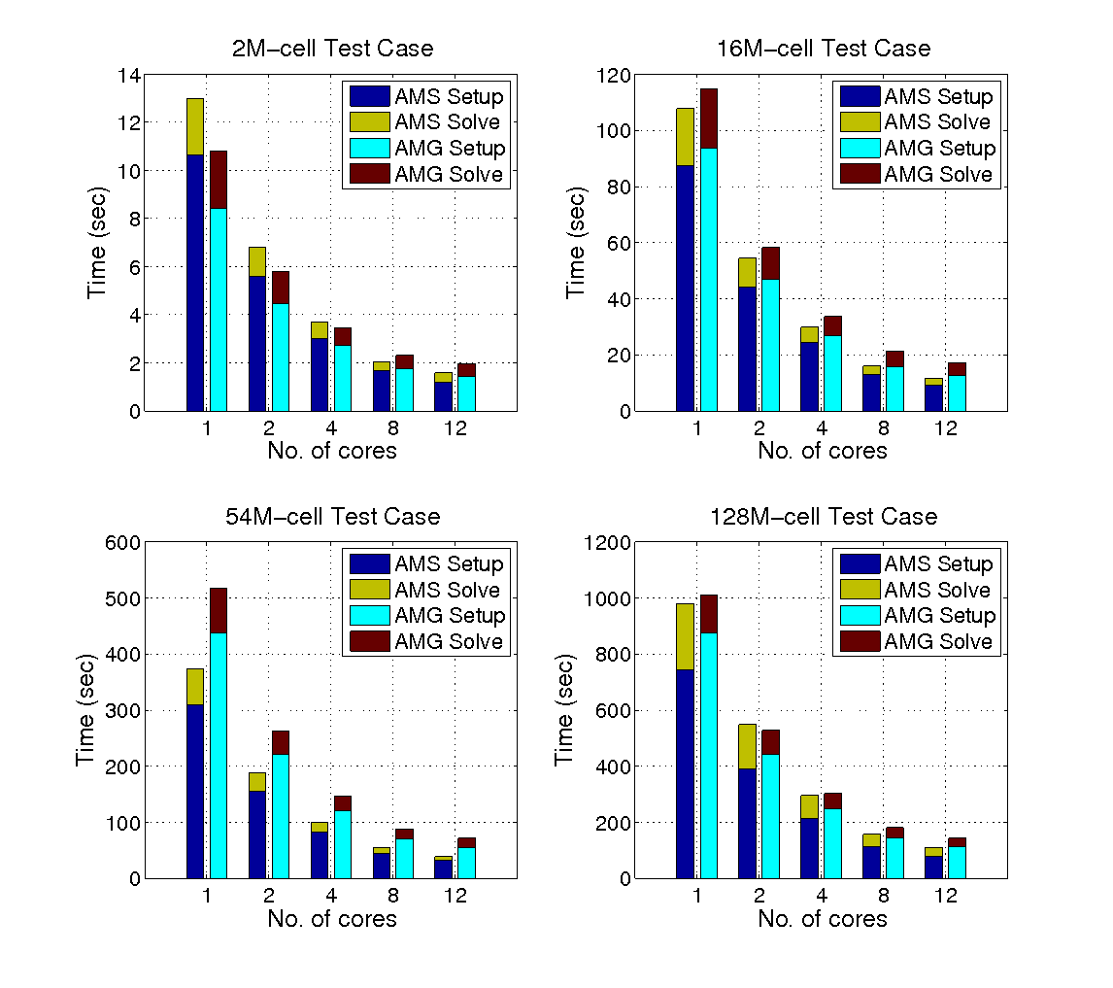
SAMG vs. AMS
(2x Intel® Xeon® E5-2620 v2)

Slide 14
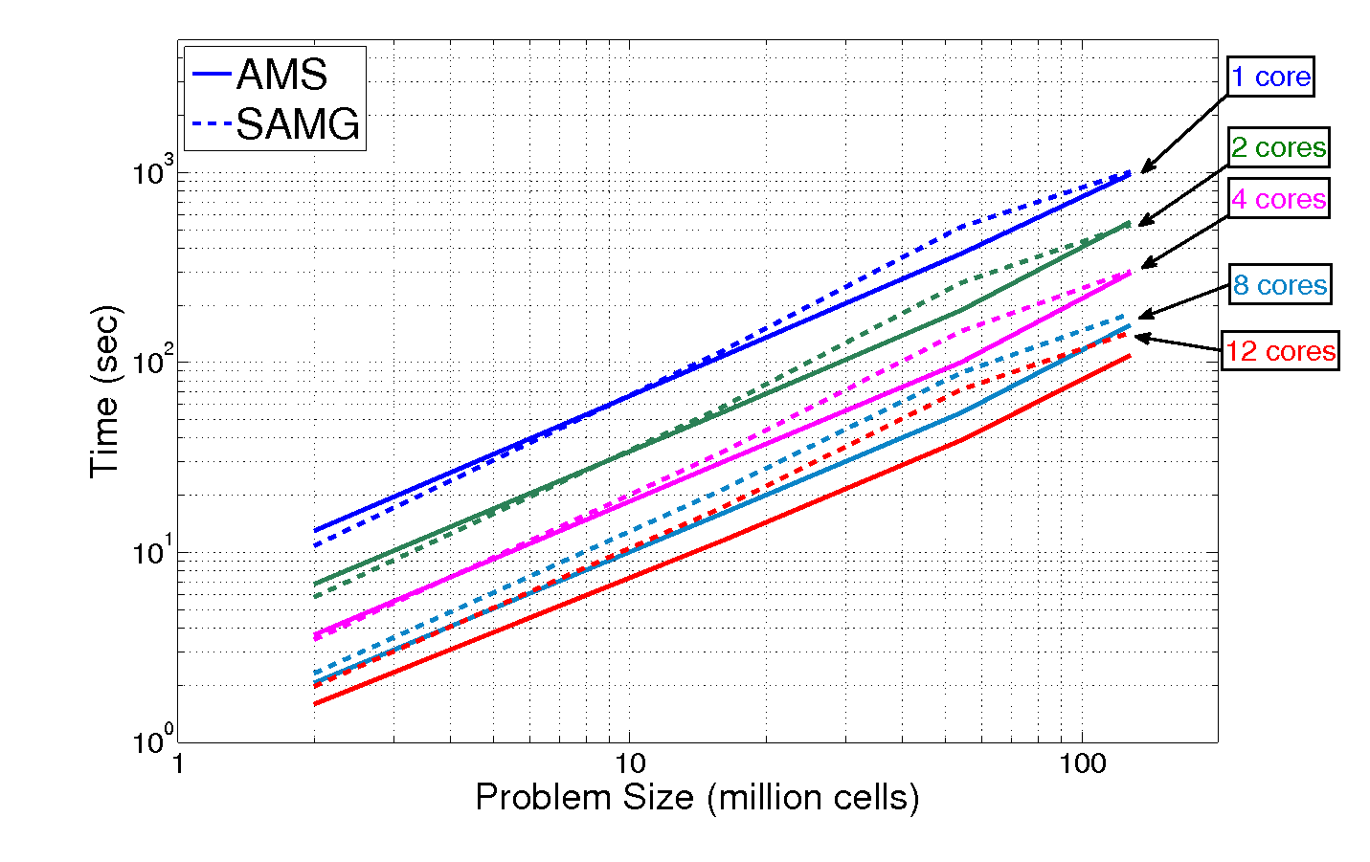

Slide 15
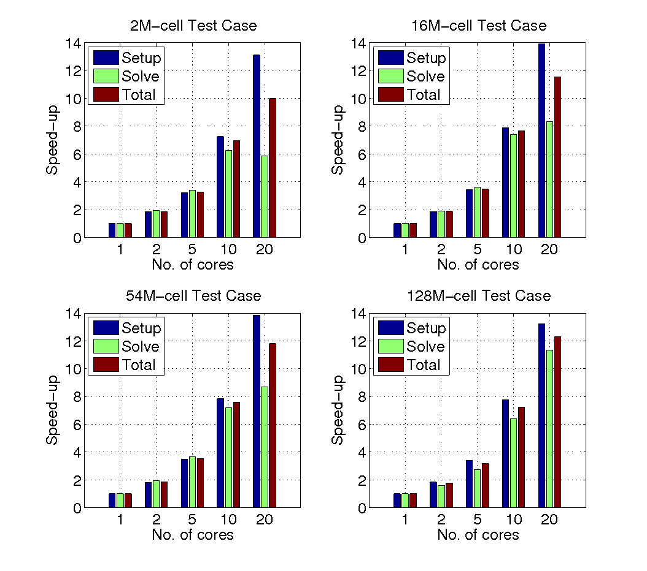
(2x Intel® Xeon® E5-2690 v2)

Slide 16
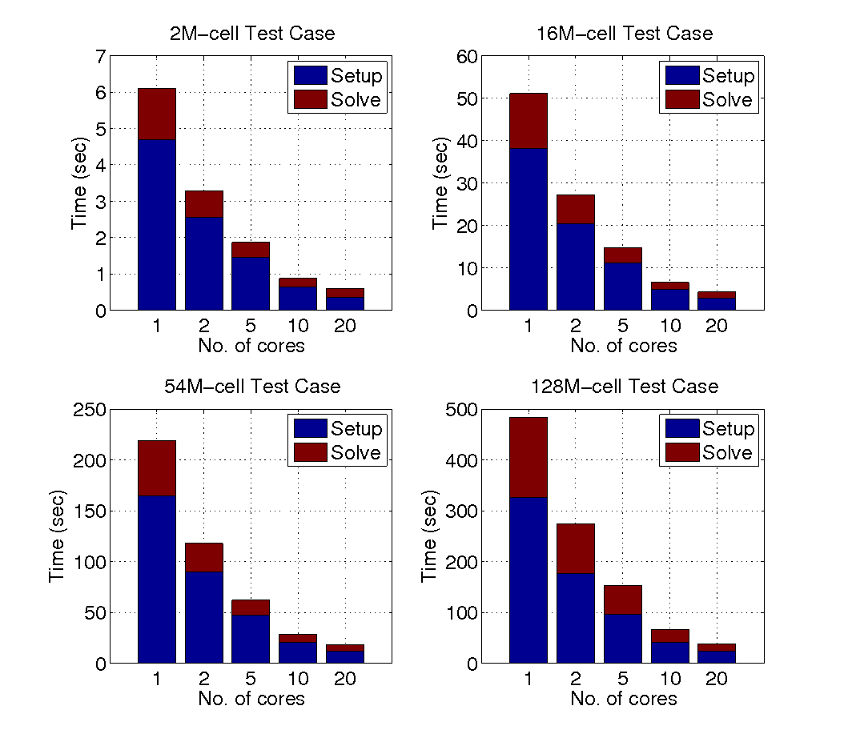
(2x Intel® Xeon® E5-2690 v2)

Slide 17
Summary
Algorithms bridge applications & hardware
  Parallelism cannot always be retconned into code
  Rethinking algorithms that expose parallelism and suit hardware yields superior results
Future work
  Xeon Phi implementation nearly satisfactory
    Some instruction-bound parts of factorization to be addressed
  Multi-node implementation
  Multi-level coarsening for arbitrary problem sizes
  Tuning of local stage

Slide 18
Thank you

