Slide 1
Towards an explicit RTM stencil computation framework on KALRAY TURBOCARD2
Yann Kalemkarian | yann.kalemkarian@kalrayinc.com
Benoît Ganne | benoit.ganne@kalrayinc.com
Chris Piercy | christopher.piercy@kalrayinc.com

Slide 2
What are we doing at Kalray
We design processors, and produce them :
It is called MPPA
We design some boards :
One with 4 MPPA, looks like an accelerator
We have a software ecosystem :
Compile, link with optimized libraries, debug with cycle accurate tools

Slide 3
Kalray at a glance
Fabless semiconductor company founded in 2008
Industry-recognized R&D teams, with unique experience in developing leading-edge many-core technologies (HW, SW and overall system)
Holds significant patents (50+) and continues to extend its portfolio
US, Japan & France

Slide 4
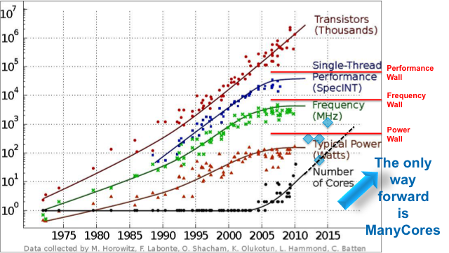
Real Time SuperComputing on a Chip
Kalray recognized critical industry needs
how to provide more processing performance without increasing power consumption
how to integrate more and more applications and functions into a single chip
while guaranteeing the response time (latency)
The industry has reached physical limits
since 2005 due to thermal dissipation
Parallel processing approaches become
necessary:
Multi-cores architectures: standard CPU duplicated
Many Cores: optimized CPUs in performance/size and power duplicated n times

Slide 5
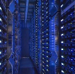
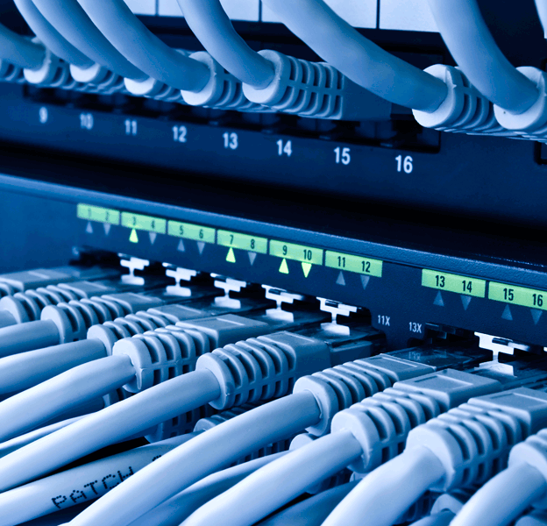
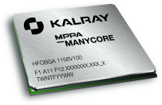
Kalray created: Real Time Supercomputing on a Chip
to address the following Markets:
INTENSIVE COMPUTING
Oil and Gas
Finance / HFT
Crypto / Defense
Numerical Simulation
Life sciences
Real Time CLOUD COMPUTING
Video Broadcast
Software Defined Network
Network Function Virtualization
Software Defined Storage
EMBEDDED SYSTEMS
Transport
Aerospace/Defence
Industrial Automation

Slide 6
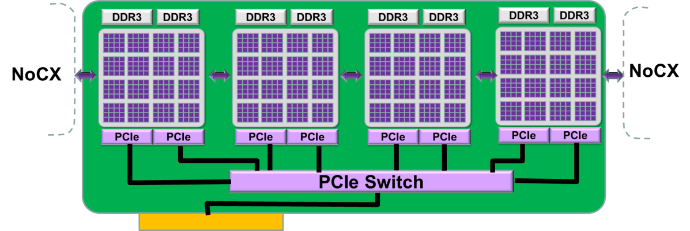
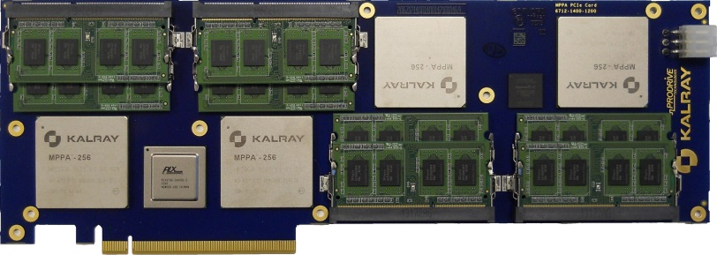
KALRAY TURBOCARD2 scalable accelerator key facts
PCIe Gen3 16x
IEEE-754 SP/DP FPU
8 DDR3 channels
Up to 32GB DDR SODIMM
Up to 100GB/s
1024+ cores, 128MB on-chip memory
Scalable
Direct multi-boards interconnects
Low latency
Standard tools
C, C++, FORTRAN, OpenMP
GCC-4.9 and GDB-7.3
OpenCL
Notes:
Read +

Slide 7
KALRAY TURBOCARD Roadmap
TURBOCARD2: available now
4 x MPPA-256 ANDEY @400MHz
1 TFLOPS SP / 300 GFLOPS DP
32GB DDR3 1600 MT/s, 8-channels
Up to 4 TFLOPS SP / RU (eg. HP SL270)
Up to 1.2 TFLOPS DP / RU (eg. HP SL270)
TURBOCARD3: available 4Q ‘15
4 x MPPA-256 BOSTAN @800MHz
3.2 TFLOPS SP / 1.6 TFLOPS DP
64 bits architecture
64GB DDR3 2133 MT/s, 8-channels
Up to 13 TFLOPS SP / RU
Up to 6.4 TFLOPS DP / RU
Software 100% compatible w/ TURBOCARD2

Slide 8
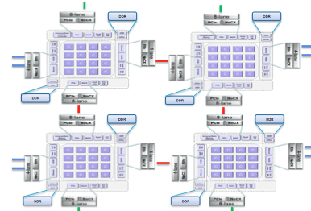
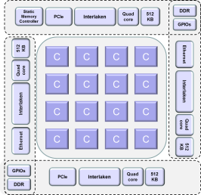
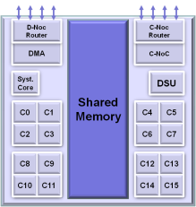
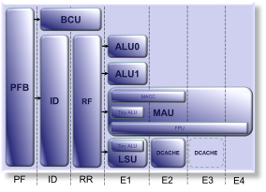
KALRAY TURBOCARD2 scalable accelerator Details
1024 Kalray programmable cores
TURBOCARD2
Manycore Processor
Compute Cluster
VLIW Core
4 MPPA-256 processors
8 DDR3 SODIM
PCIe Gen3 16x to host
NoCX between MPPA
16 compute clusters
4 I/O subsystems with quad-core SMP and DDR memory access
2 Networks-on-Chip
16 PE cores + 1 RM core
NoC Tx and Rx interfaces
Debug Support Unit (DSU)
2 MB of shared memory
5-issue VLIW architecture
Predictability & energy efficiency
32-bit/64-bit IEEE 754 FPU
MMU for rich OS support

Slide 9
KALRAY TURBOCARD2 S/W stack
Domain Specific Languages and Librairies
GNU C, C++, Fortran
OpenCL
Librairies
POSIX threads + OpenMP
OpenCL runtime
libNoC
Distributed Shared Memory
Kalray Exokernel
RTEMS - LINUX
MPPA® platforms
Legend
Languages
Communication
Runtime
OS

Slide 10
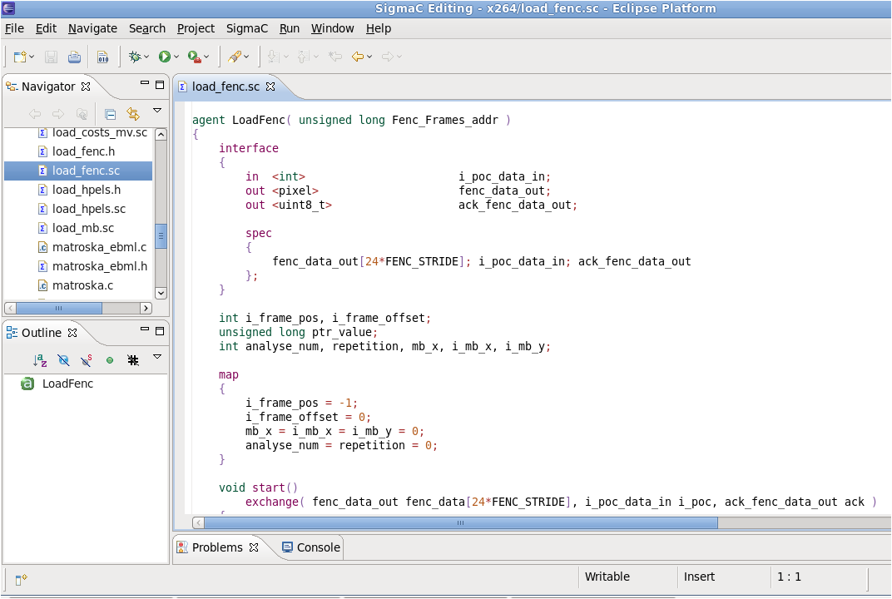
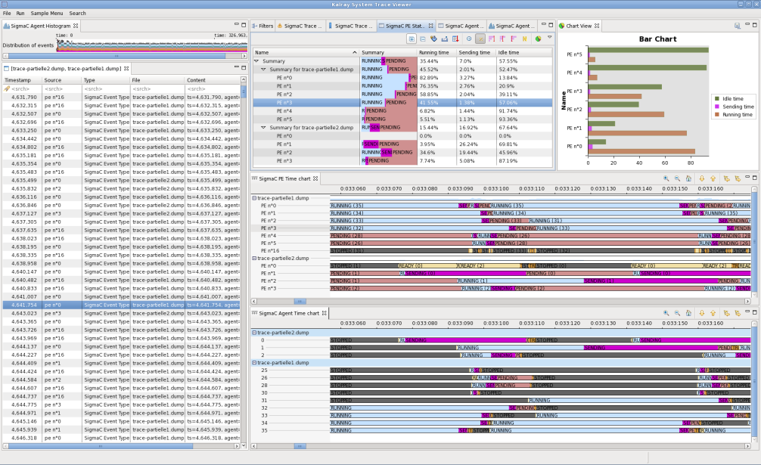
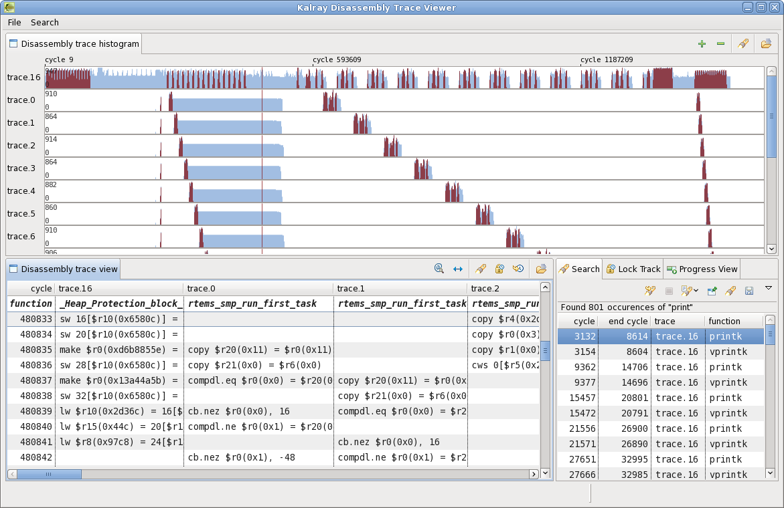
Compiler, Debuggers & System Trace
Compiler
gcc version 4.9
C89, C99, C++ and Fortran
GNU Binary utilities 2011 (assembler, linker, objdump, objcopy, etc.)
Standard C libraries: uClibc, Newlib +
Linear Assembly Optimizer (LAO) for VLIW Optimizations
Debuggers
GDB version 7.3
Each core seen as a thread
Watchpoint / breakpoint/ …
System trace
Linux Trace Toolkit NG based
low latency
on demand activation
Eclipse-based system trace viewer
Deep insight of execution at system level

Slide 11
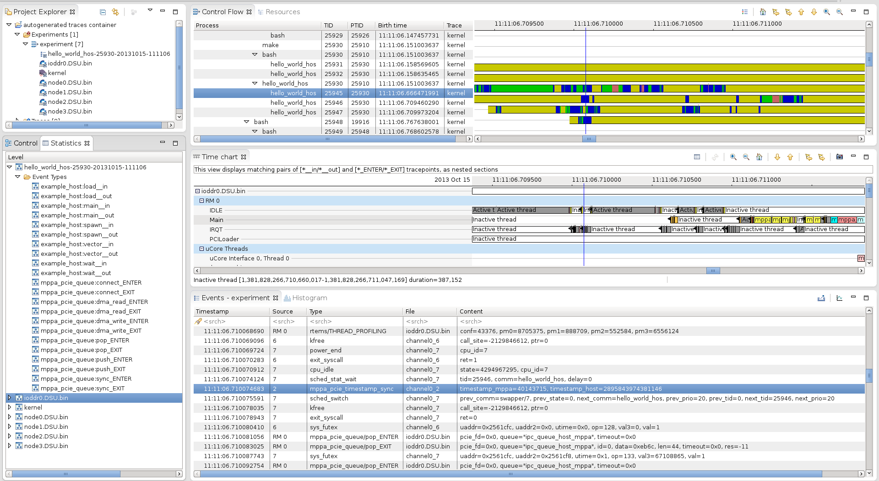
MPPA trace viewer

Slide 12
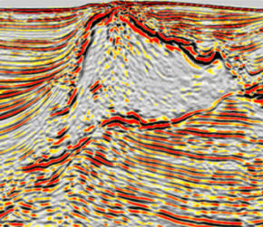
Port the Science, not the code!
Standard OpenMP programming model
GCC / GFORTRAN / G++
Dedicated libraries for specific domains
HEVC
x265/FFMPEG seamless integration
Cryptography
OpenSSL support
Financials Monte Carlo
State-of-the-art optimized RNG libraries
Oil & Gas seismic migration
Optimized stencils libraries

Slide 13
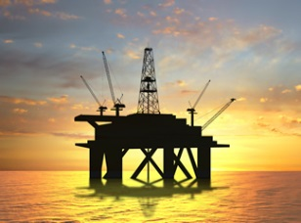
KALRAY TURBOCARD2, serving the Next Generation Oil and Gas
Optimized core
Massively Parallel: 1024 compute cores
No branching / SIMD penalty
IEEE-754 SP/DP FPU
Performance Scalability
Linear scaling with number of cores
Network on chip extension (NoCX) for Multi-TURBOCARD2 systems
High density
High computation capability with low power consumption Turbocard2:
1TFlops for Turbocard2
100W
32GB of 8-channels DDR3 on board
Software reuse
Reuse existing seismic kernels
C/C++/Fortran
GCC/GFORTRAN 4.9
OpenMP-3
Full-flavored debug environment
GDB
Flexible trace system

Slide 14
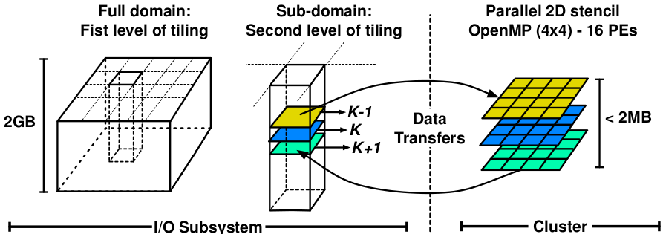
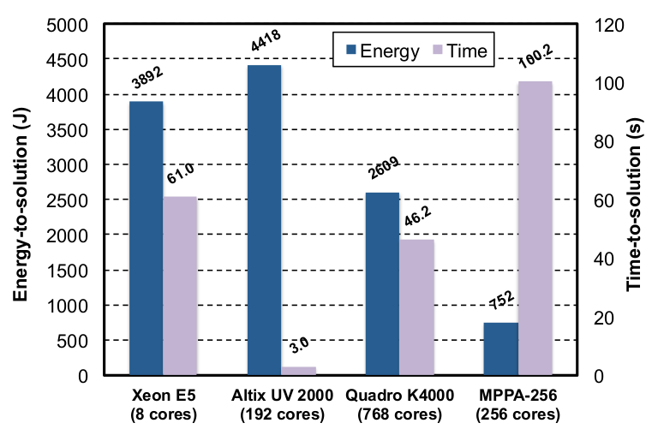
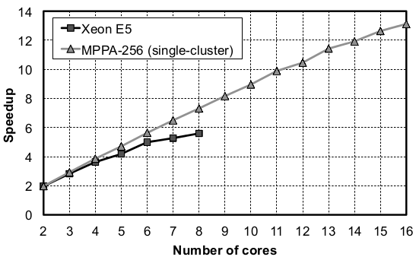
Study : Seismic processing on MPPA (single chip)
Marcio Castro, Fabrice Dupros, Emilio Francesquini, Jean-François Méhaut, and Philippe O. A. Navaux: Energy Efficient Seismic Wave Propagation Simulation on a Low-power Manycore Processor, Europar14 (Aug 2014), Portugal

Slide 15
Study : Seismic processing on MPPA (single chip)
Marcio Castro, Fabrice Dupros, Emilio Francesquini, Jean-François Méhaut, and Philippe O. A. Navaux: Energy Efficient Seismic Wave Propagation Simulation on a Low-power Manycore Processor, Europar14 (Aug 2014), Portugal
Notes:
Used « prefetching scheme »

Slide 16
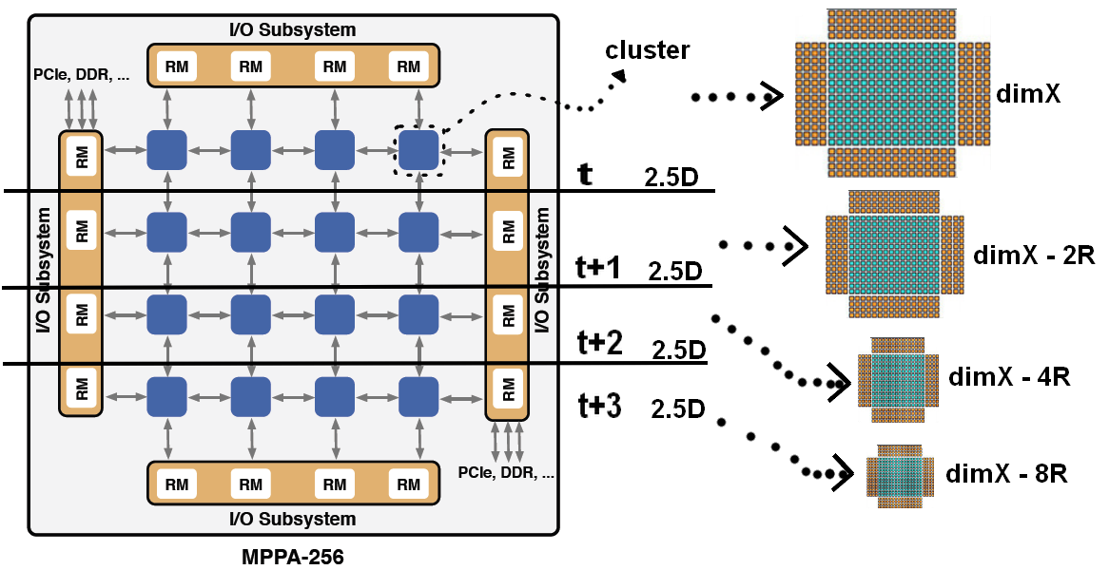
Seismic processing on TURBOCARD2
Stencil computation is mostly IO-bound
Memory speed is the bottleneck
Prefetching scheme to overlap communication and computation
Improve previous work by optimizing memory use
Use maximum DDR channels
Improve compute vs bandwidth ratio with time skewing
3.5K: time skewing
through pipelining
Leverage TURBOCARD2
architecture,
- 6R

Slide 17
Seismic processing on TURBOCARD2
R
dimX
x
y
dimX

Slide 18
Seismic processing on TURBOCARD2
ISO-3DFD example
Implemented on the MPPA using C compiler
domain and velocity matrix, dimX = 152, R = 4
2.5D combined bandwidth
$Read+Write=T×Z ×\frac{X ×Y}{{dimX}^{2}}×({\left(dimX+2×R\right)}^{2}+{dimX}^{2})$
3.5K combined bandwidth, 2 timesteps
$Read+Write=\frac{T}{2}×Z ×\frac{X ×Y}{{dimX′}^{2}}×\left({\left(dimX^{′}+4×R\right)}^{2}+2×{dimX^{′}}^{2}\right) with dimX^{′}=dimX−2×R$
Theorical ratio vs 2.5D: 30% less bandwidth needed
Experimental results: 53% of performance increase
5.6 Gcells/sec, which makes 0.07 Gcells/s/watt on Turbocard

Slide 19
Conclusion on Seismic processing
Multi-level domain decomposition is cumbersome
Optimization is hard on many platforms despite having tools
Halo sharing,
Time skewing,
Minimize datamovement, maximize the efficiency by reuse
Why doing it ever and ever again?
Can we help people by providing a Seismic interface to offload stencil computation on our accelerator ?

Slide 20
Kalray Seismic imaging on TURBOCARD2 Work-In-Progress
The seismic kernels are recompiled from the same source for TURBOCARD
x86
x86 + TURBOCARD
Seismic kernels
C/C++/Fortran
Seismic kernels
C/C++/Fortran
Kalray Seismic
Host API
PCIe
Kalray Seismic Runtime
Pipeline setup,
Datamovers,
calling kernels
Seismic Imaging Processing Pipeline (workload scheduling, shots access, snapshots management…)
Seismic Imaging Processing Pipeline (workload scheduling, shots access, snapshots management…)
Kalray will provide an easy API interface with the Seismic kernels
The seismic imaging processing pipeline is left untouched. Only the calls to the seismic kernels are modified to call Kalray Seismic Host API
Notes:
Petits bouts de codes par rapport au reste, pas de filesystem,…
Idée: on prend les kernels sans retoucher le cœur des boucles
Multilevel domain decomposition
Host_API_Inputs (*kernels pointer, int rayon_stencil, matrice_3D domain, matrice_3D velocity, ….)
To extract the « kernels » from production
- Kalray sismic runtime : pipeline setup dynamically, synchro, kalray datamover,, steps management, call les kernels, synchro

Slide 21
Thank you for your attention!
Yann Kalemkarian | yann.kalemkarian@kalrayinc.com
Benoît Ganne | benoit.ganne@kalrayinc.com
Chris Piercy | christopher.piercy@kalrayinc.com

