Slide 1
Rice University
2015 Oil & Gas HPC Workshop

Slide 2
The Decade of Data Mining
“Finding and extracting oil and gas for the sub surface has always been a data-driven exercise” - Peter Breuning, Chevron
Oil & Gas has an exponential increase in:
The amount of data that is mined
Compute & communications systems to process & move data
Technology required to increase efficiencies

Slide 3
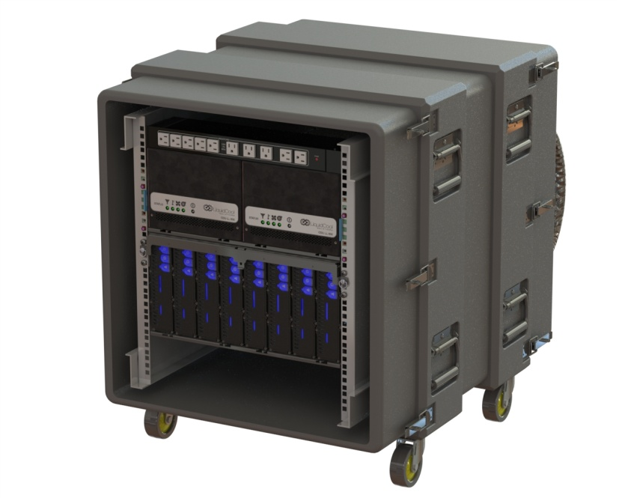
“HPC Anywhere” Efficiencies:
Compute at the source
Slash latency
Move less raw data
Very High Reliability
No contamination, clogging
No fans, CRAC, CRAH
Shrink costs
40% less energy
75% less space
Very low maintenance

Slide 4
How LiquidCool Technology Works
Total Liquid Submersion
100% of device electronics are submerged in Core CoolantTM
Core Coolant is a non-hazardous, non-volatile, low-density dielectric liquid with 1,400 times the volumetric heat capacity of air
Directed-Flow Technology
Within a device “cool” Core Coolant is circulated directly to the components with the highest power density
The remaining components are cooled by bulk flow as Core Coolant is drawn through the unit to a return line

Slide 5
Reliability
LCS technology decouples electronics from the environment, eliminating the root causes of failure:
Dramatic reduction in thermal fluctuations, which drive solder joint failures
Much lower operating temperatures for the board and components (typically 20-30 C cooler device temps than with air)
No oxidation/corrosion of electrical contacts
No fretting corrosion of electrical contacts induced by structural vibration
No moving parts within the device enclosure (fan failures are one of the highest service triggers for electronics)
No exposure to electrostatic discharge events
No sensitivity to ambient particulate, humidity, or temperature conditions
When maintenance is required to :
The swap out procedure takes less than 2 minutes with no measurable loss of fluid
An IT device can be removed from a rack, drained, opened, serviced, reassembled, refilled, and reinstalled within a 15 minute turnaround window

Slide 6
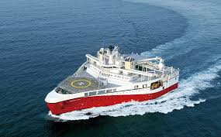
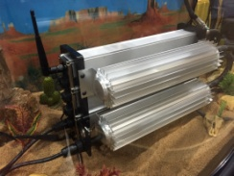
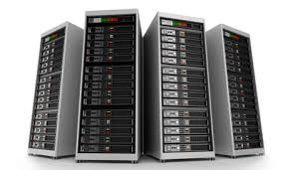
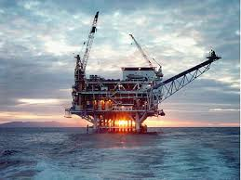
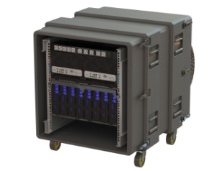
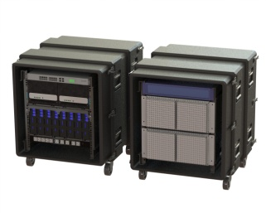
“HPC Anywhere”
Move part of the Compute directly to the data collection source

Slide 7
Thank you!
Jay Ford, V.P. Sales & Marketing
Jay.Ford@LiquidCoolSolutions.com
7

